Slide 1
Coordination Chemistry
Ligands
classified according to the number of donor atoms
Examples
monodentate = 1
bidentate = 2
tetradentate = 4
hexadentate = 6
polydentate = 2 or more donor atoms
chelating agents

Slide 2
Ligands
Monodentate
Examples:
H₂O, CN⁻, NH₃, NO₂⁻, SCN⁻, OH⁻, X⁻ (halides), CO, O²⁻
Example Complexes
[Co(NH₃)₆]³⁺
[Fe(SCN)₆]³⁻

Slide 3
Ligands
Bidentate
Examples
oxalate ion = C₂O₄²⁻
ethylenediamine (en) = NH₂CH₂CH₂NH₂
ortho-phenanthroline (o-phen)
Example Complexes
[Co(en)₃]³⁺
[Cr(C₂O₄)₃]³⁻
[Fe(NH₃)₄(o-phen)]³⁺

Slide 4
Ligands
oxalate ion
ethylenediamine
*
*
*
*
ortho-phenanthroline
*
*
Donor Atoms

Slide 5
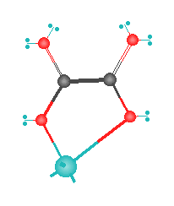
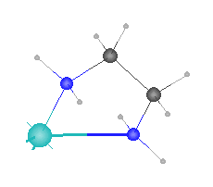
Ligands
oxalate ion
ethylenediamine
H
C
C
O
M
N
M

Slide 6
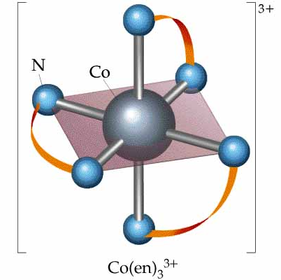
Ligands

Slide 7
Ligands
Hexadentate
ethylenediaminetetraacetate (EDTA) = (O₂CCH₂)₂N(CH₂)₂N(CH₂CO₂)₂⁴⁻
Example Complexes
[Fe(EDTA)]⁻¹
[Co(EDTA)]⁻¹

Slide 8
Ligands
EDTA
*
*
*
*
*
*
Donor Atoms

Slide 9
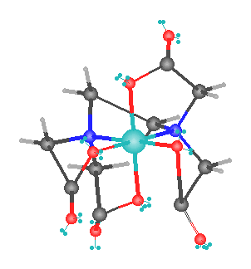
Ligands
EDTA
O
H
C
N
M

Slide 10
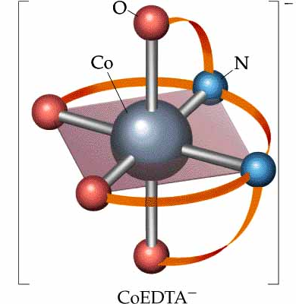
Ligands
EDTA

Slide 11
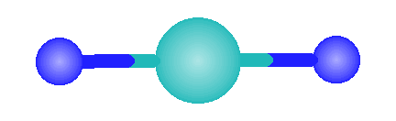
Common Geometries of Complexes
Coordination Number Geometry
2
Linear
Example: [Ag(NH₃)₂]⁺

Slide 12
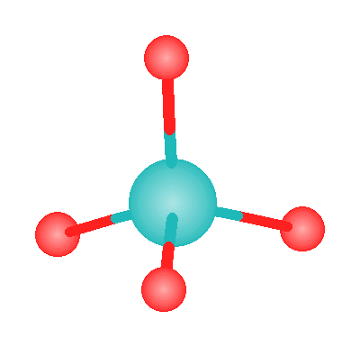
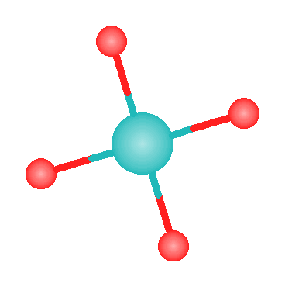
Common Geometries of Complexes
Coordination Number Geometry
4
tetrahedral
Examples: [Zn(NH₃)₄]²⁺, [FeCl₄]⁻
square planar
Example: [Ni(CN)₄]²⁻

Slide 13
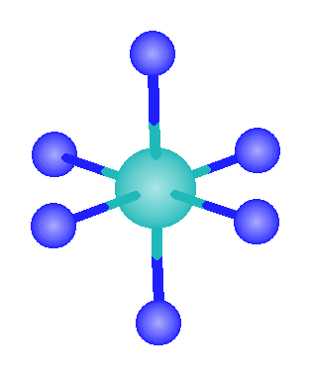
Common Geometries of Complexes
Coordination Number Geometry
6
Examples: [Co(CN)₆]³⁻, [Fe(en)₃]³⁺
octahedral

Slide 14
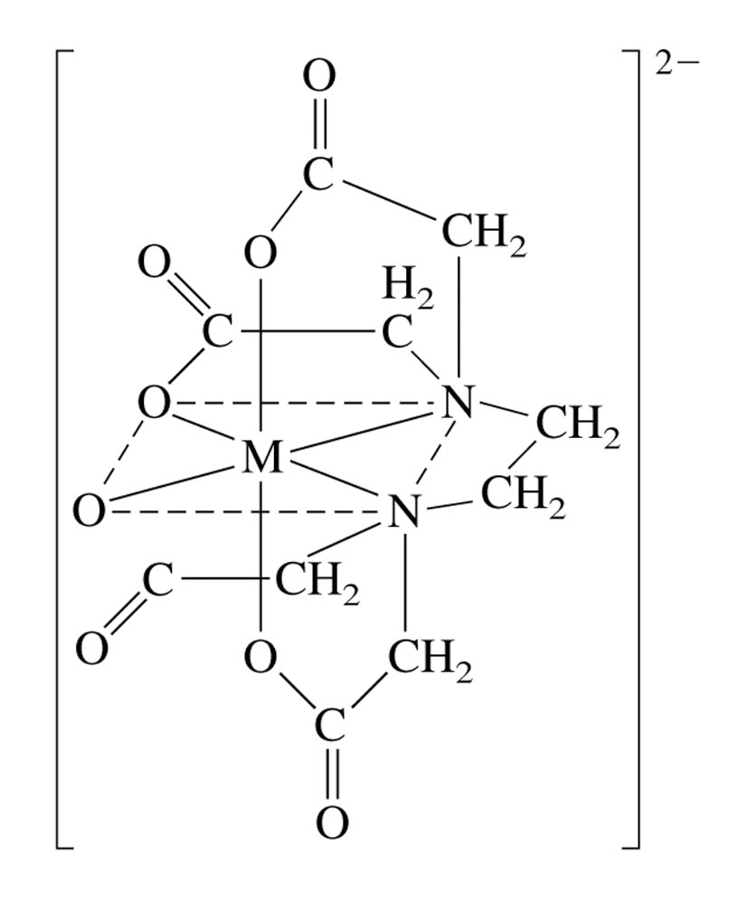
The Coordination of EDTA with a 2+ Metal Ion
ethylenediaminetetraacetate

Slide 15
Rules for Naming Coordination Compounds
[Co(NH₃)₅Cl]Cl₂
Cation is named before the anion.
“chloride” goes last (the counterion)
Ligands are named before the metal ion.
ammonia (ammine) and chlorine
(chloro) named before cobalt

Slide 16
Rules for Naming Coordination Compounds
[Co(NH₃)₅Cl]Cl₂
For negatively charged ligands, an “o” is added to the root name of an anion (such as fluoro, bromo, chloro, etc.).
The prefixes mono-, di-, tri-, etc., are used to denote the number of simple ligands.
penta ammine

Slide 17
Rules for Naming Coordination Compounds
[Co(NH₃)₅Cl]Cl₂
The oxidation state of the central metal ion is designated by a Roman numeral:
cobalt (III)
When more than one type of ligand is present, they are named alphabetically:
pentaamminechloro

Slide 18
Rules for Naming Coordination Compounds
[Co(NH₃)₅Cl]Cl₂
If the complex ion has a negative charge, the suffix “ate” is added to the name of the metal.
The correct name is:
pentaamminechlorocobalt(III) chloride

Slide 19
Naming coordination compounds (new)
The following rules are used when naming coordination compounds:
(i) ligand names are listed before the name of the central atom,
(ii) no spaces are left between parts of the name that refer to the same coordination entity,

Slide 20
(iii) ligand names are listed in alphabetical order
Note: (numerical prefixes indicating the number of ligands are not considered in determining that order),
(iv) the use of abbreviations in names is discouraged.

Slide 21
Example:
1. [CoCl(NH₃)₅]Cl₂
pentaamminechloridocobalt(ll) chloride
pentaamminechloridocobalt(2+) chloride
2. [AuXe₄]²⁺
tetraxenonidogold(ll)
(i) Prefixes di, tri, etc. are generally used for simple ligands. Enclosing marks are not required.
(ii) Prefixes bis, tris, tetrakis, etc. are used with complex expressions and when required to avoid ambiguity.
For example, one would use diammine, for (NH₃)₂, but bis(methylamine), for (NH₂Me)₂, to make a distinction from dimethylamine.

Slide 22
Systematic and alternative names for some common ligands:
(i) Names of anionic ligands, whether inorganic or organic, are modified to end in 'o‘
In general, if the anion name ends in 'ide', 'ite' or 'ate', the final 'e' is replaced by 'o', giving 'ido', 'ito', and 'ato', respectively.
In particular, alcoholates, thiolates, phenolates, carboxylates, partially dehydronated amines, phosphanes, etc.
In its complexes, hydrogen is always treated as anionic. 'Hydrido' is used for hydrogen coordinating to all elements including boron.

Slide 23
(ii) Names of neutral and cationic ligand names, including organic ligands, are used without modification (even if they carry the endings 'ide', 'ite' or 'ate').
(iii) Enclosing marks are required for neutral and cationic ligand names, for inorganic anionic ligands containing numerical prefixes (such as triphosphato), for any compositional name (such as carbon disulfide), for any substituted organic ligand.
However, common ligands such as aqua, ammine, carbonyl, nitrosyl, methyl, ethyl, etc., do not require enclosing marks, unless there is ambiguity.

Slide 24
Examples:
Formula Ligand name
1. Cl_ chlorido
2. CN_ cyanido
3. H_ hydrido
4. D_ or H_ deuterido or [2H]hydrido
5. PhCH₂CH₂Se_ phenylethaneselanolato
6. MeCOO_ acetato or ethanoato
7. Me₂N dimethylazanido or dimethylamido
8. MeCONH₂ acetamide (not acetamido)
9. MeCONH_ acetylazanido or acetylamido (not acetamido)
10. MeNH₂ methanamine
11. MeNH methylazanido or methanaminido
12. MePH₂ methylphosphane
13. MePH_ methylphosphanido
14. MeOS(O)OH methyl hydrogen sulfite
15. MeOS(O)O_ methyl sulfito, or methoxidodioxidosulfato(1-)

Slide 25
Exercise
Name the following coordination compounds.
(a) [Co(H₂O)₆]Br₃ (b) Na₂[PtCl₄]
(a) Hexaaquacobalt(III) bromide
(b) Sodium tetrachloroplatinate(II)
Notes:
a) hexaaquacobalt(III) bromide
b) sodiumtetrachloro-platinate(II)

Slide 26
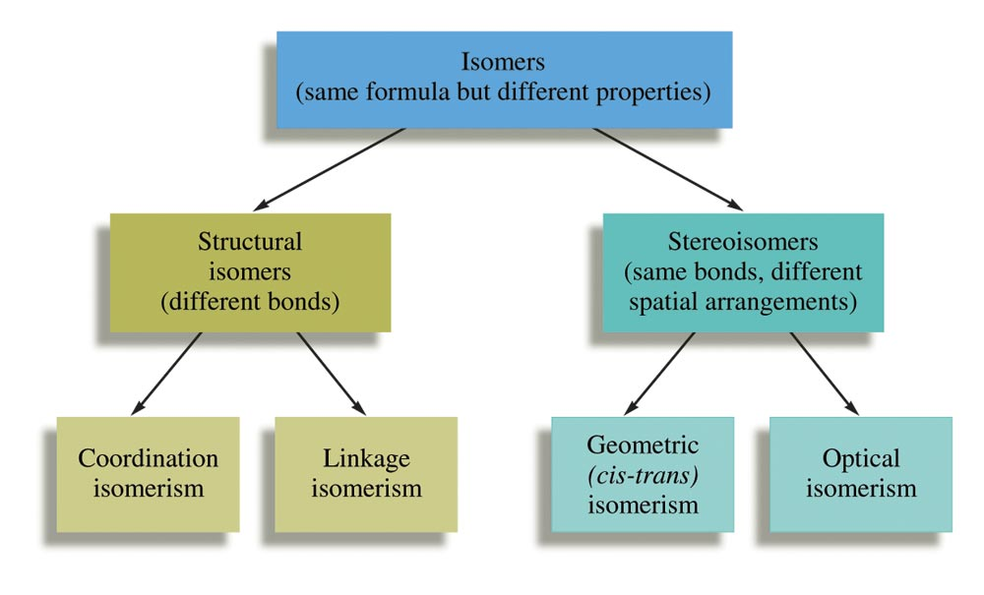
Some Classes of Isomers

Slide 27
Structural Isomerism
Coordination Isomerism:
Composition of the complex ion varies.
[Cr(NH₃)₅SO₄]Br and [Cr(NH₃)₅Br]SO₄
Linkage Isomerism:
Composition of the complex ion is the same, but the point of attachment of at least one of the ligands differs.

Slide 28
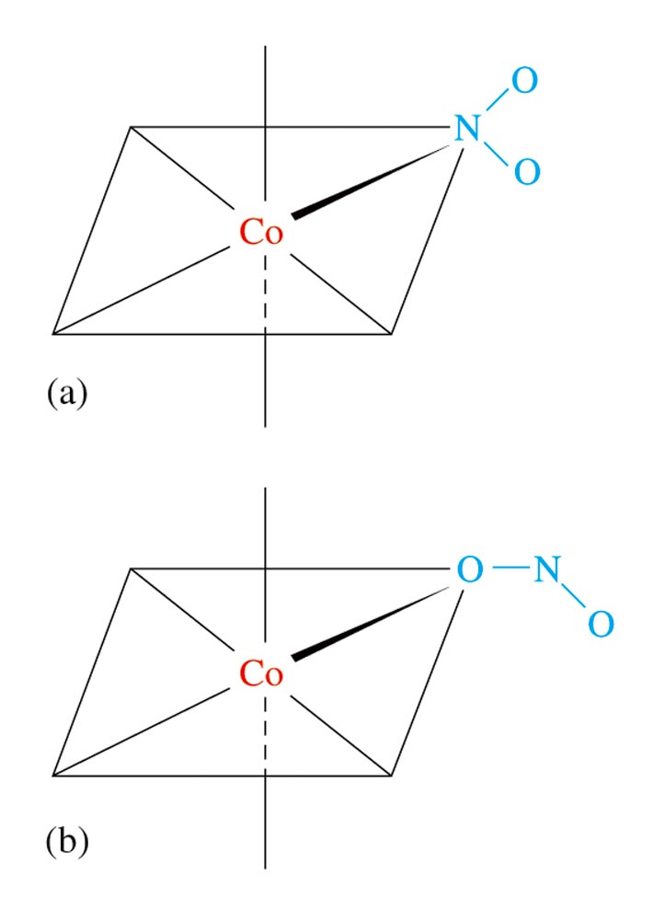
Linkage Isomerism of NO₂–

Slide 29
Stereoisomerism
Geometrical Isomerism (cis-trans):
Atoms or groups of atoms can assume different positions around a rigid ring or bond.
Cis – same side (next to each other)
Trans – opposite sides (across from each other)

Slide 30
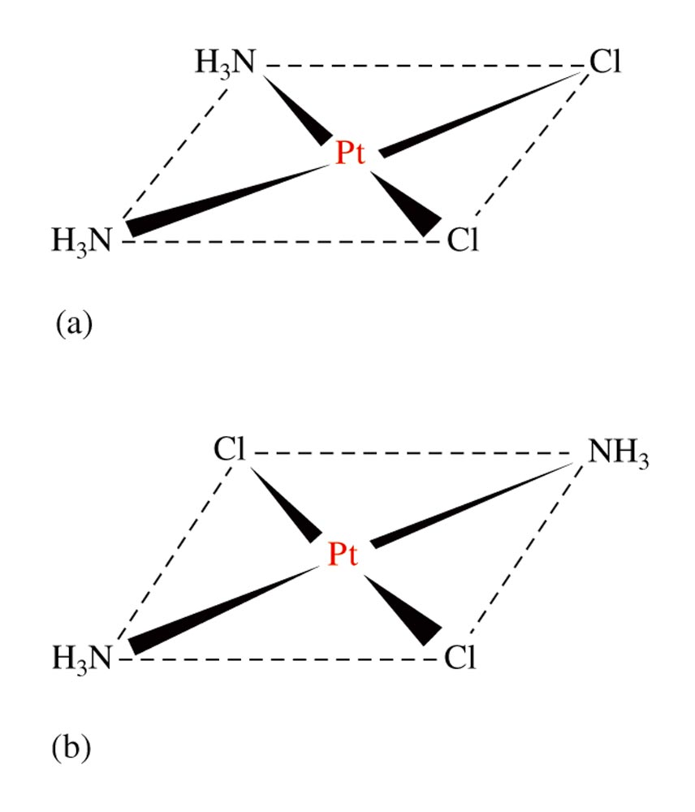
Geometrical (cis-trans) Isomerism for a Square Planar Compound (a) cis isomer (b) trans isomer

Slide 31
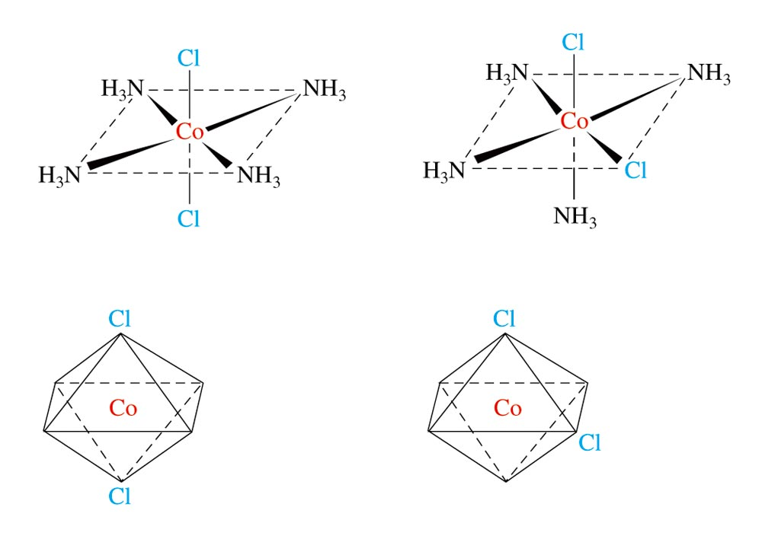
Geometrical (cis-trans) Isomerism for an Octahedral Complex Ion

Slide 32
Stereoisomerism
Optical Isomerism:
Isomers have opposite effects on plane-polarized light.

Slide 33
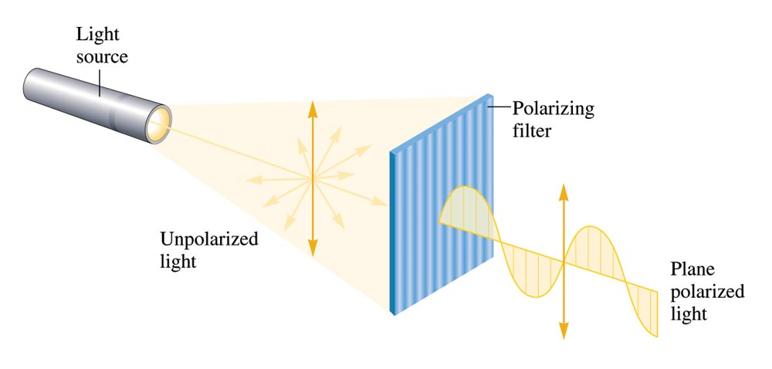
Unpolarized Light Consists of Waves Vibrating in Many Different Planes

Slide 34
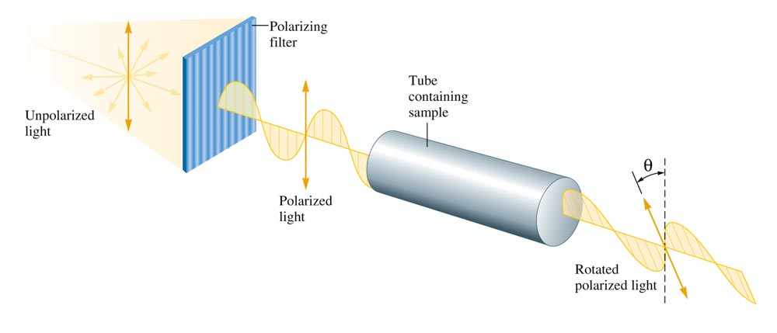
The Rotation of the Plane of Polarized Light by an Optically Active Substance

Slide 35
Optical Activity
Exhibited by molecules that have nonsuperimposable mirror images (chiral molecules).
Enantiomers – isomers of nonsuperimposable mirror images.

Slide 36

A Human Hand Exhibits a Nonsuperimposable Mirror Image

Slide 37
Does [Co(en)₂Cl₂]Cl exhibit geometrical isomerism?
Yes
Does it exhibit optical isomerism?
Trans form – No
Cis form – Yes
Notes:
See Figure 21.17. [Co(en)₂Cl₂]Cl exhibits geometrical isomerism (trans and cis forms). The trans form does not exhibit optical isomerism but the cis form does exhibit optical isomerism.

Slide 38
Bonding in Complex Ions
The VSEPR model for predicting structure generally does not work for complex ions.
However, assume a complex ion with a coordination number of 6 will have an octahedral arrangement of ligands.
And, assume complexes with two ligands will be linear.
But, complexes with a coordination number of 4 can be either tetrahedral or square planar.

Slide 39
Bonding in Complex Ions
2. The interaction between a metal ion and a ligand can be viewed as a Lewis acid–base reaction with the ligand donating a lone pair of electrons to an empty orbital of the metal ion to form a coordinate covalent bond.

Slide 40
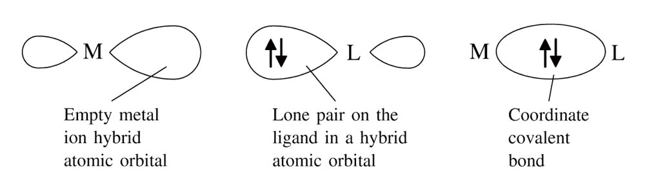
The Interaction Between a Metal Ion and a Ligand Can Be Viewed as a Lewis Acid-Base Reaction

Slide 41
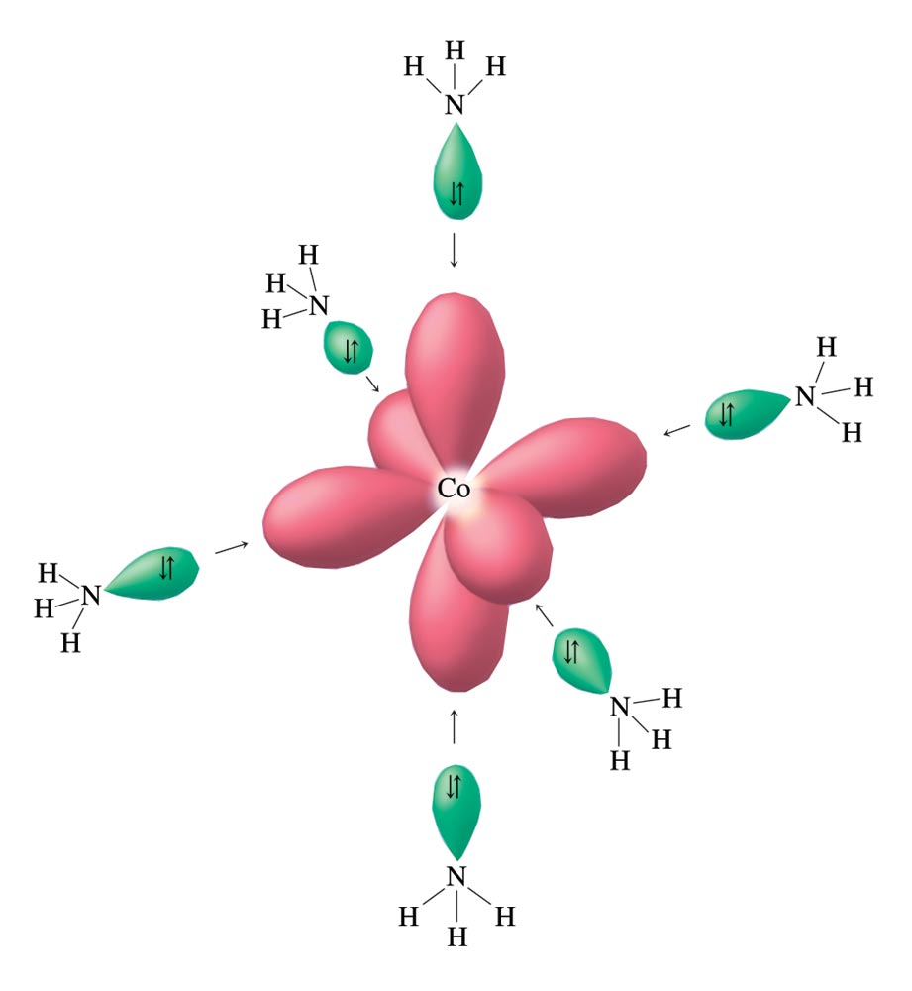
Hybrid Orbitals on Co³⁺ Can Accept an Electron Pair from Each NH₃ Ligand

Slide 42
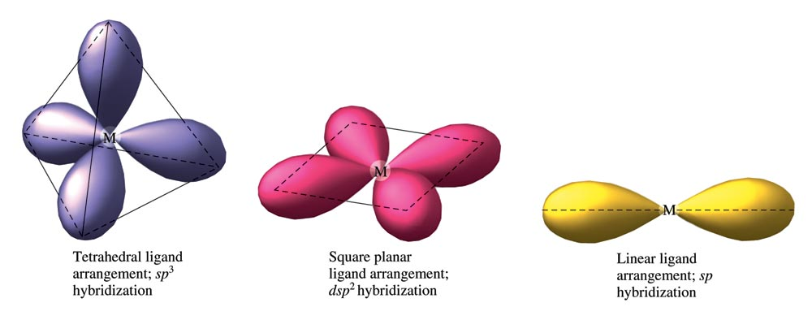
The Hybrid Orbitals Required for Tetrahedral, Square Planar, and Linear Complex Ions

Slide 43
Crystal Field Model
Focuses on the effect of ligands on the energies of the d orbitals of metals.
Assumptions
Ligands are negative point charges.
Metal–ligand bonding is entirely ionic:
strong-field (low–spin):
large splitting of d orbitals
weak-field (high–spin):
small splitting of d orbitals

Slide 44
Octahedral Complexes
point their lobes directly at the point-charge ligands.
point their lobes between the point charges.

Slide 45
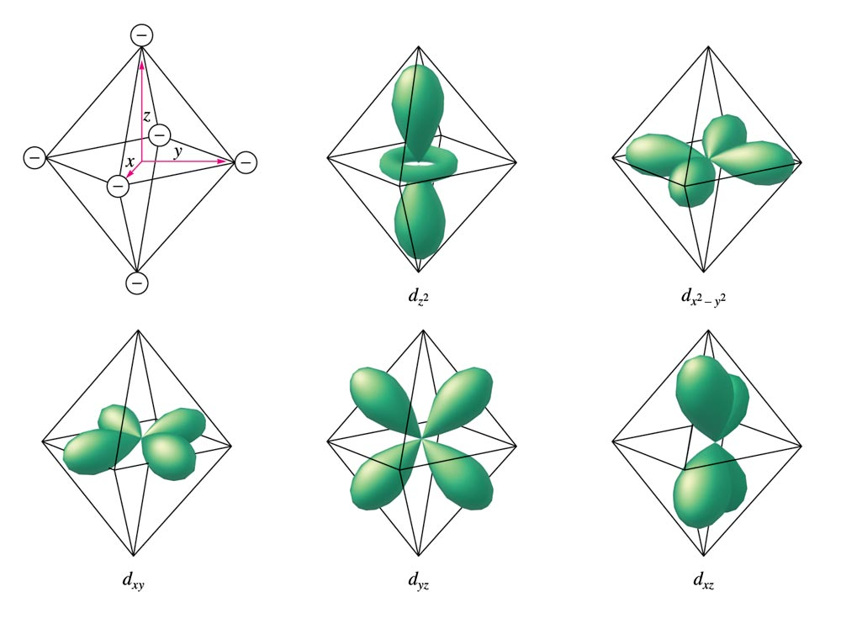
An Octahedral Arrangement of Point-Charge Ligands and the Orientation of the 3d Orbitals

Slide 46
Which Type of Orbital is Lower in Energy?
Because the negative point-charge ligands repel negatively charged electrons, the electrons will first fill the d orbitals farthest from the ligands to minimize repulsions.
The orbitals are at a lower energy in the octahedral complex than are the orbitals.

Slide 47
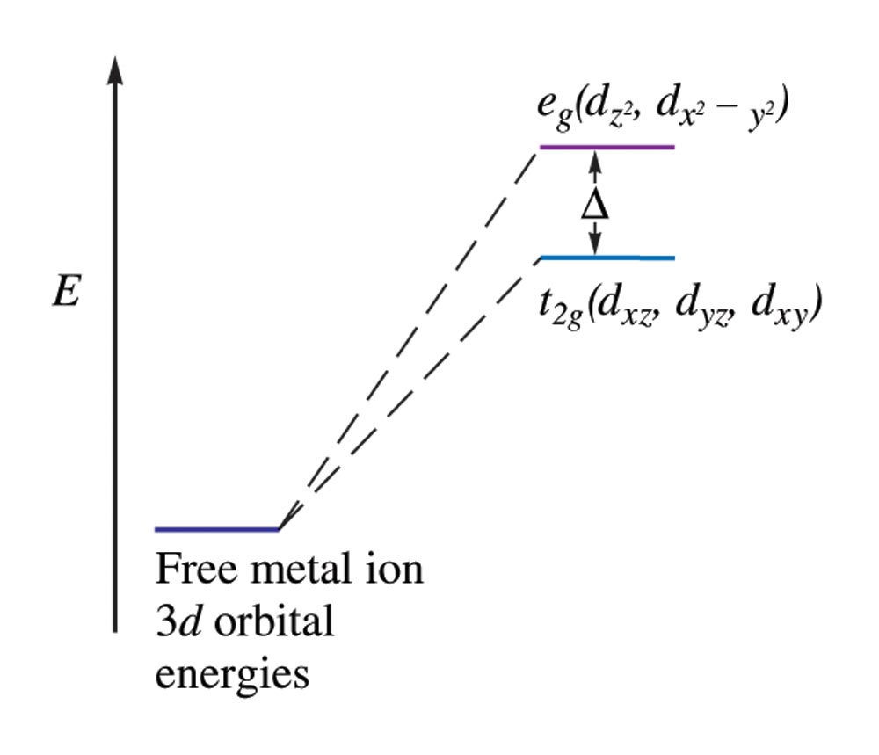
The Energies of the 3d Orbitals for a Metal Ion in an Octahedral Complex

Slide 48
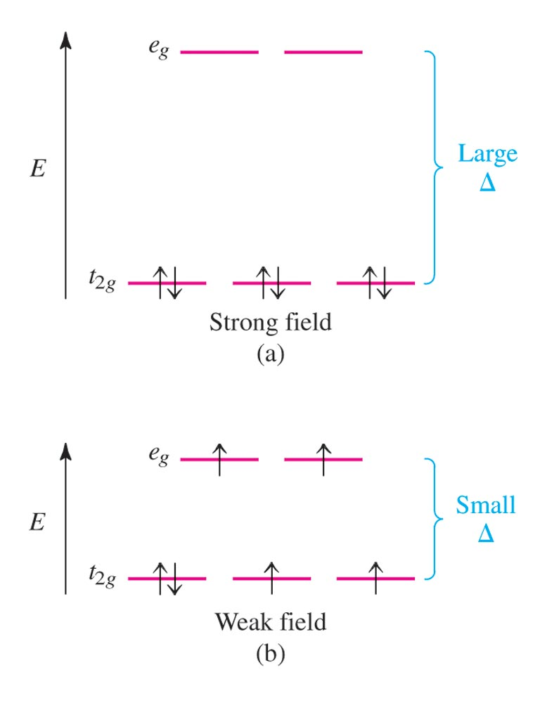
Possible Electron Arrangements in the Split 3d Orbitals in an Octahedral Complex of Co³⁺

Slide 49
Magnetic Properties
Strong–field (low–spin):
Yields the minimum number of unpaired electrons.
Weak–field (high–spin):
Gives the maximum number of unpaired electrons.
Hund’s rule still applies.

Slide 50
Spectrochemical Series
Strong–field ligands to weak–field ligands.
(large split) (small split)
CN– > NO₂– > en > NH₃ > H₂O > OH– > F– > Cl– > Br– > I–
Magnitude of split for a given ligand increases as the charge on the metal ion increases.

Slide 51
Complex Ion Colours
When a substance absorbs certain wavelengths of light in the visible region, the colour of the substance is determined by the wavelengths of visible light that remain.
Substance exhibits the colour complementary to those absorbed.

Slide 52
Complex Ion Colours
The ligands coordinated to a given metal ion determine the size of the d–orbital splitting, thus the colour changes as the ligands are changed.
A change in splitting means a change in the wavelength of light needed to transfer electrons between the t_{2g} and e_{g} orbitals.

Slide 53
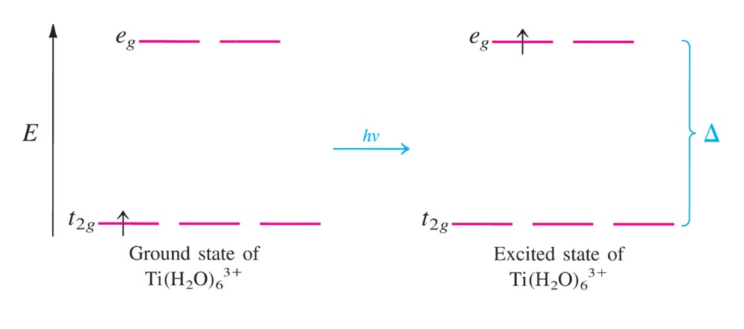
Absorbtion of Visible Light by the Complex Ion Ti(H₂O)₆³⁺

Slide 54
Which of the following are expected to form colourless octahedral compounds?
Ti⁴⁺ Cr³⁺ Mn²⁺
Fe²⁺ Fe³⁺ Co²⁺
Co³⁺ Ni²⁺ Cu⁺
Cu²⁺ Zn²⁺ Ag⁺
Notes:
There are 4 colorless octahedral compounds. These are either d¹⁰ ions (Zn²⁺, Cu⁺, Ag⁺), or the d⁰ ion (Ti⁴⁺). If electrons cannot move from one energy level to the next in the energy level diagram, there is no color absorbed.

Slide 55
Tetrahedral Arrangement
None of the 3d orbitals “point at the ligands”.
Difference in energy between the split d orbitals is significantly less.
d–orbital splitting will be opposite to that for the octahedral arrangement.
Weak–field case (high–spin) always applies.

Slide 56
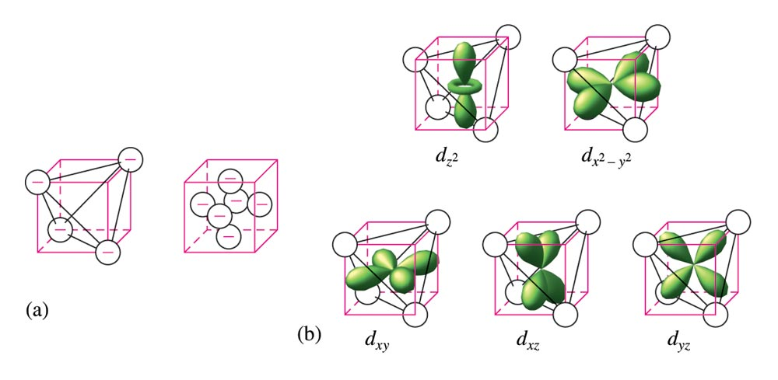
The d Orbitals in a Tetrahedral Arrangement of Point Charges

Slide 57
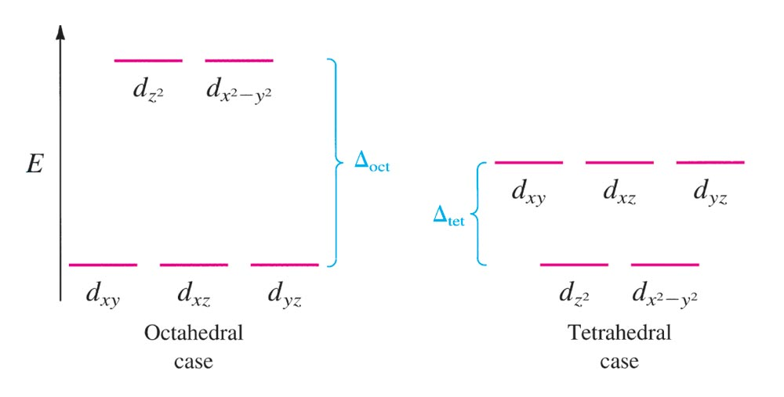
The Crystal Field Diagrams for Octahedral and Tetrahedral Complexes

Slide 58
Consider the Crystal Field Model (CFM).
Which is lower in energy, d–orbital lobes pointing toward ligands or between? Why?
The electrons in the d–orbitals – are they from the metal or the ligands?
Notes:
In all cases these answers explain the crystal field model. The molecular orbital model is a more powerful model and explains things differently. However, it is more complicated. This is another good time to discuss the role of models in science.
a) Lobes pointing between ligands are lower in energy because we assume ligands are negative point charges. Thus, orbitals (with electron probability) pointing at negative point charges will be relatively high in energy.
b) The electrons are from the metal.

Slide 59
Consider the Crystal Field Model (CFM).
Why would electrons choose to pair up in d–orbitals instead of being in separate orbitals?
Why is the predicted splitting in tetrahedral complexes smaller than in octahedral complexes?
Notes:
c) Since some orbitals are higher in energy than others (see "a"), electrons may actually be lower in energy by pairing up than by jumping up in energy to be in a separate orbital.
d) In an octahedral geometry there are some orbitals pointing directly at ligands. Thus, there is a greater energy difference between these (larger splitting).

Slide 60
Using the Crystal Field Model, sketch possible electron arrangements for the following. Label one sketch as strong field and one sketch as weak field.
Ni(NH₃)₆²⁺
Fe(CN)₆^{3–}
Co(NH₃)₆³⁺
Notes:
a) A d ⁸ ion will look the same as strong field or weak field in an octahedral complex. In each case there are two unpaired electrons.
b) This is a d ⁵ ion. In the weak field case, all five electrons are unpaired. In the strong field case, there is one unpaired electron.
c) This is a d ⁶ ion. In the weak field case, there are four unpaired electrons. In the strong field case, there are no unpaired electrons.

Slide 61
A metal ion in a high–spin octahedral complex has 2 more unpaired electrons than the same ion does in a low–spin octahedral complex.
What are some possible metal ions for which this would be true?
Metal ions would need to be d⁴ or d⁷ ions. Examples include Mn³⁺, Co²⁺, and Cr²⁺.
Notes:
Metal ions would need to be d⁴ or d⁷ ions. Examples include Mn³⁺, Co²⁺, and Cr²⁺.

Slide 62
Between [Mn(CN)₆]^{3–} and [Mn(CN)₆]^{4–} which is more likely to be high spin? Why?
Notes:
[Mn(CN)₆]⁴⁻ is more likely to be high spin because the charge on the Mn ion is 2+ while the [Mn(CN)₆]³⁻ the charge on the Mn ion is 3+. With a larger charge, there is bigger splitting between energy levels, meaning strong field, or low spin.

Slide 63
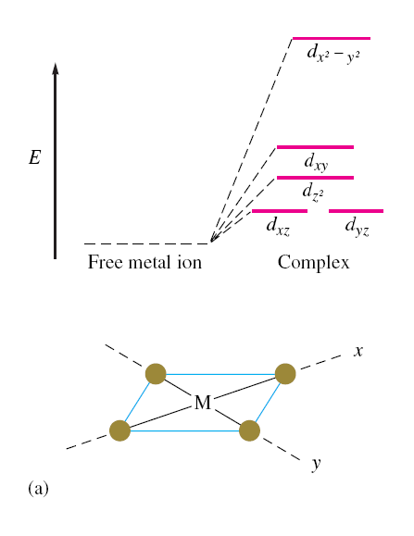
The d Energy Diagrams for Square Planar Complexes

Slide 64
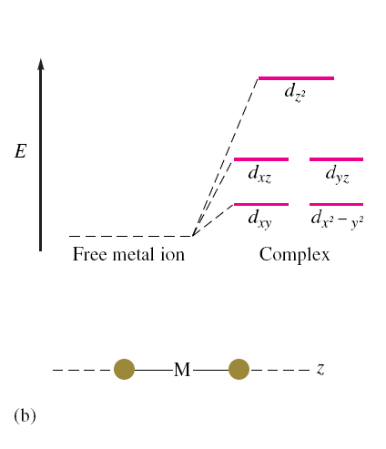
The d Energy Diagrams for Linear Complexes Where the Ligands Lie Along the z Axis

Slide 65
Transition Metal Complexes in Biological Molecules
Metal ion complexes are used in humans for the transport and storage of oxygen, as electron-transfer agents, as catalysts, and as drugs.

Slide 66
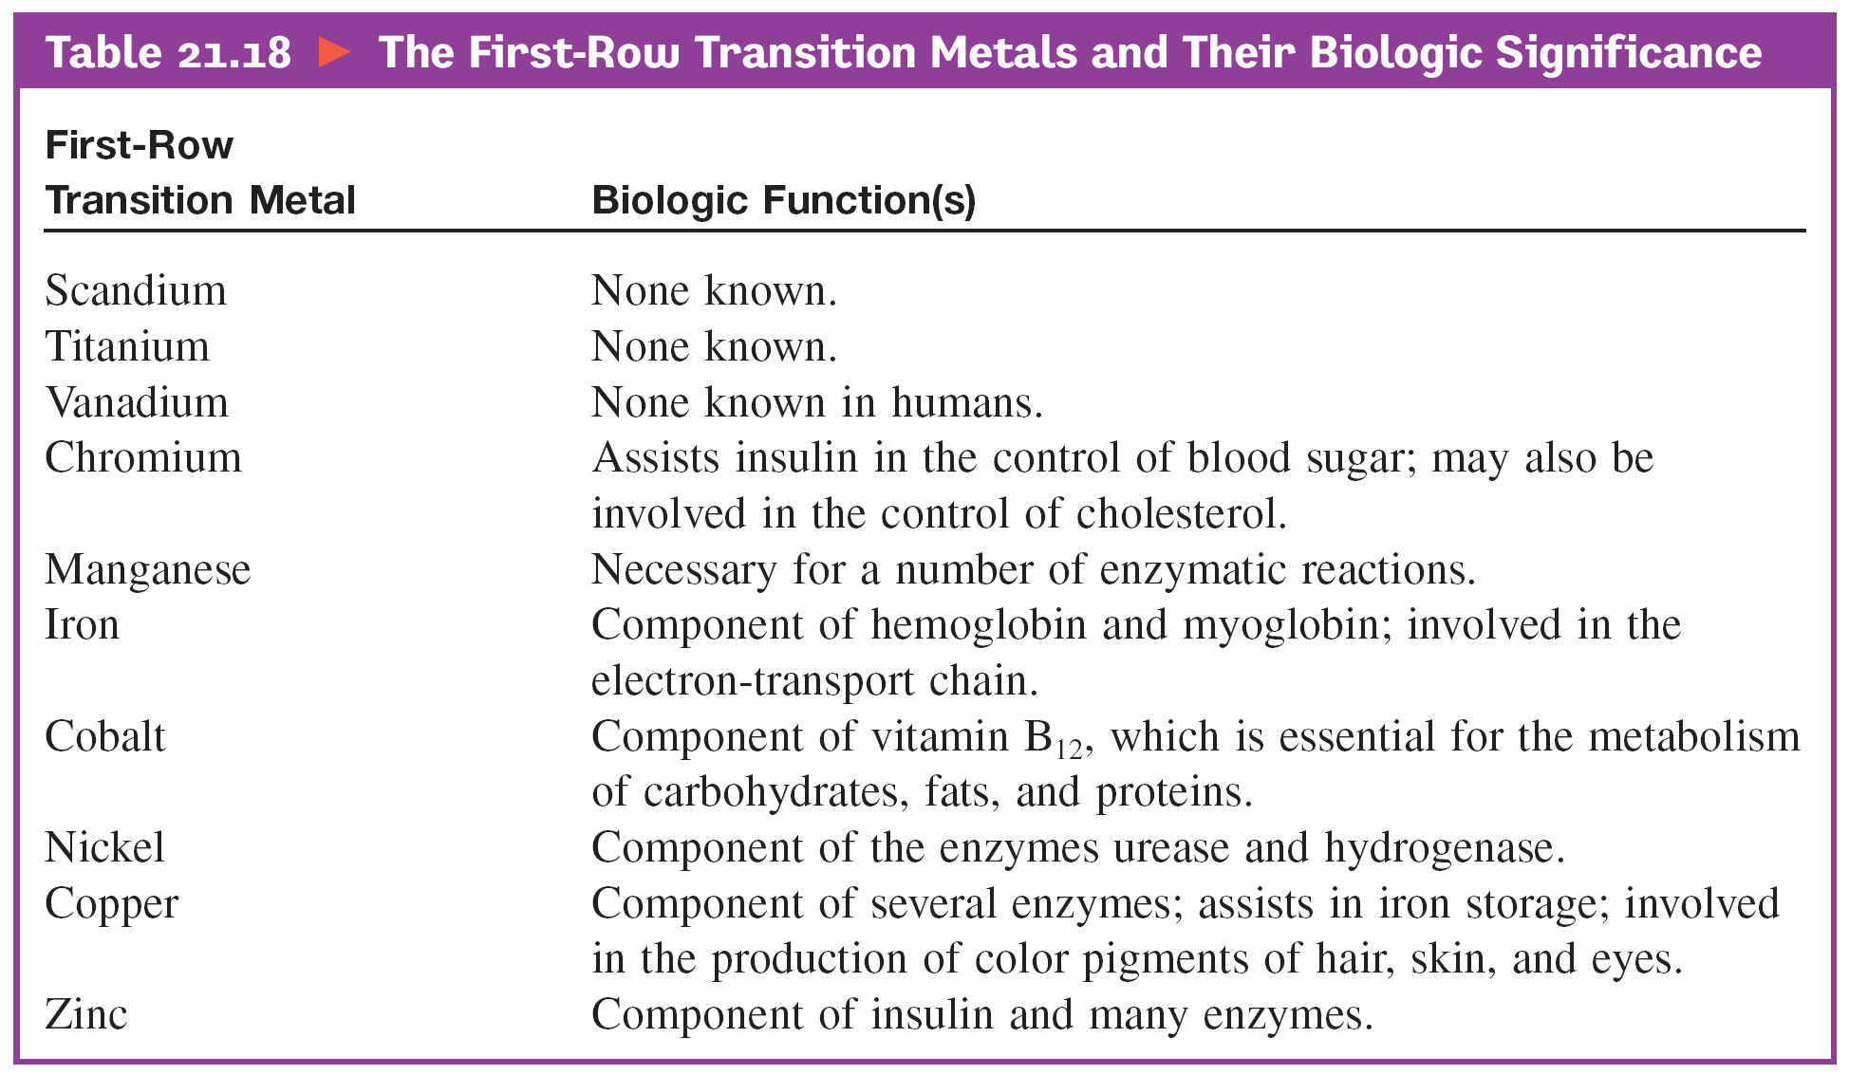
First-Row Transition Metals and Their Biological Significance

Slide 67
Biological Importance of Iron
Plays a central role in almost all living cells.
Component of hemoglobin and myoglobin.
Involved in the electron-transport chain.

Slide 68
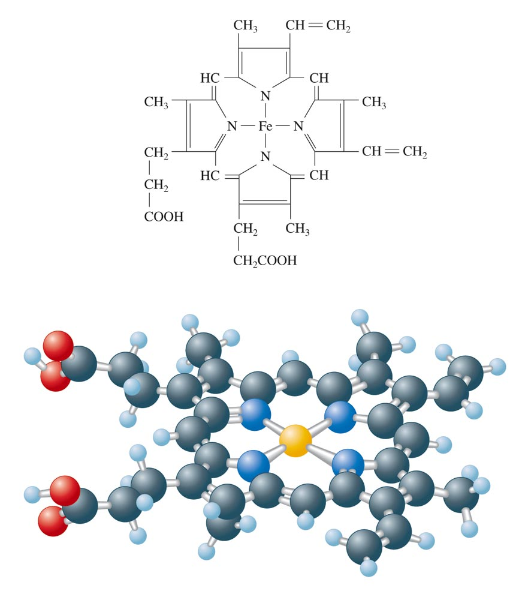
The Heme Complex

Slide 69
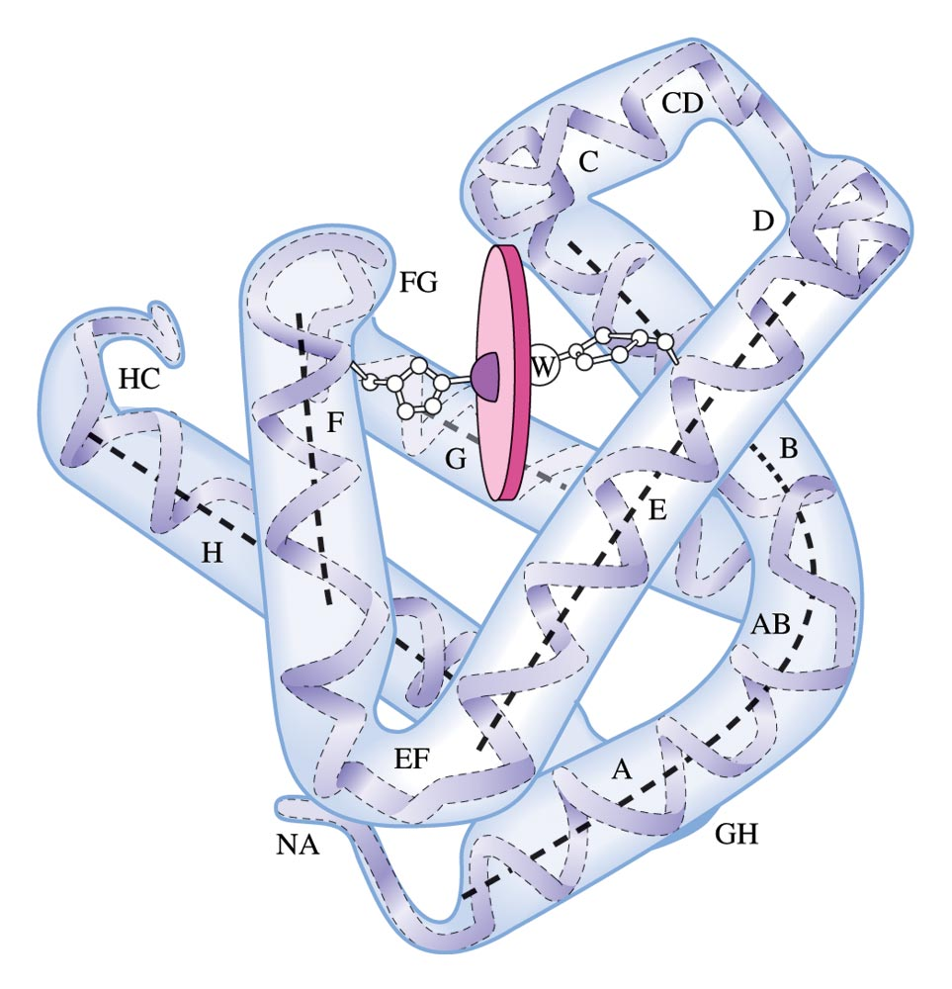
Myoglobin
The Fe²⁺ ion is coordinated to four nitrogen atoms in the porphyrin of the heme (the disk in the figure) and on nitrogen from the protein chain.
This leaves a 6th coordination position (the W) available for an oxygen molecule.

Slide 70
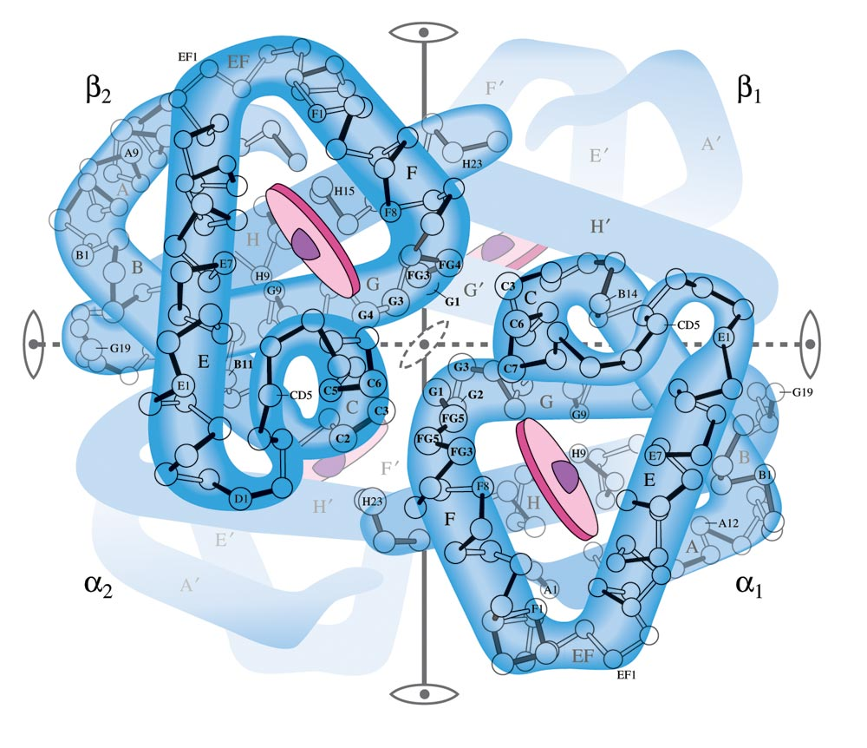
Hemoglobin
Each hemoglobin has two α chains and two β chains, each with a heme complex near the center.
Each hemoglobin molecule can complex with four O₂ molecules.

Slide 71
Metallurgy
Process of separating a metal from its ore and preparing it for use.
Steps:
Mining
Pretreatment of the ore
Reduction to the free metal
Purification of the metal (refining)
Alloying

Slide 72
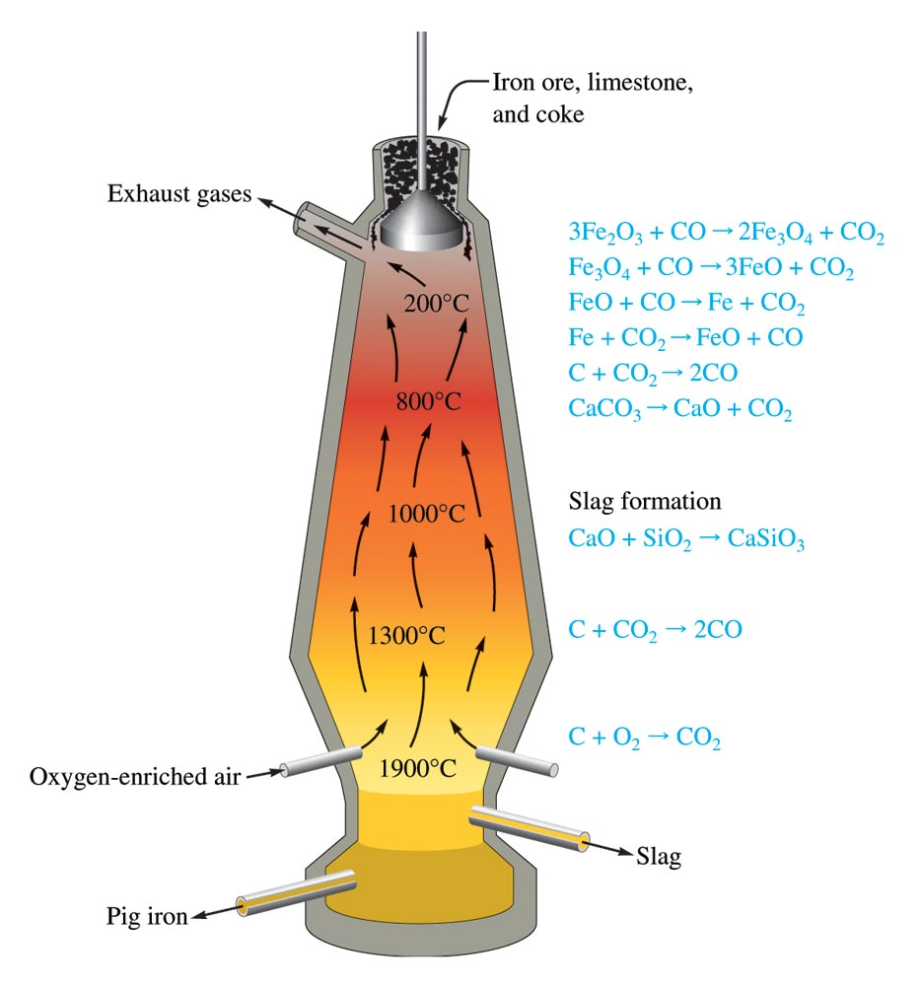
The Blast Furnace Used In the Production of Iron

Slide 73
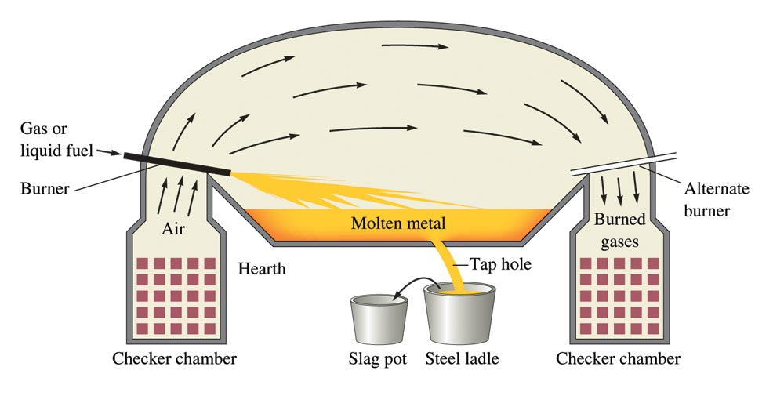
A Schematic of the Open Hearth Process for Steelmaking

Slide 74
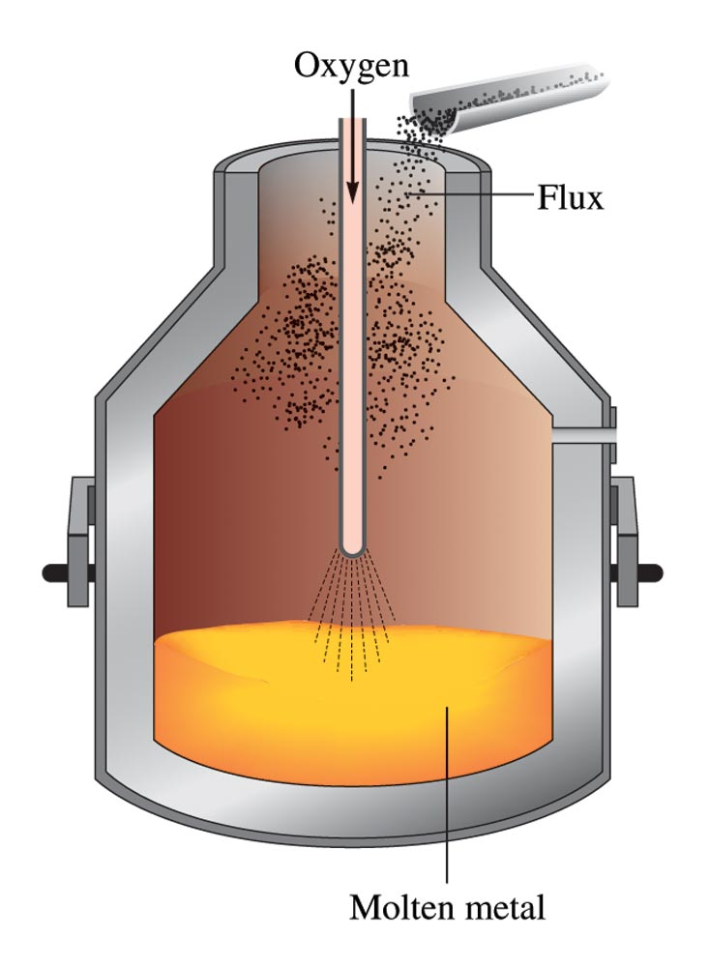
The Basic Oxygen Process for Steelmaking
Much faster.
Exothermic oxidation reactions proceed so rapidly that they produce enough heat to raise the temperature nearly to the boiling point of iron without an external heat source.

Slide 75
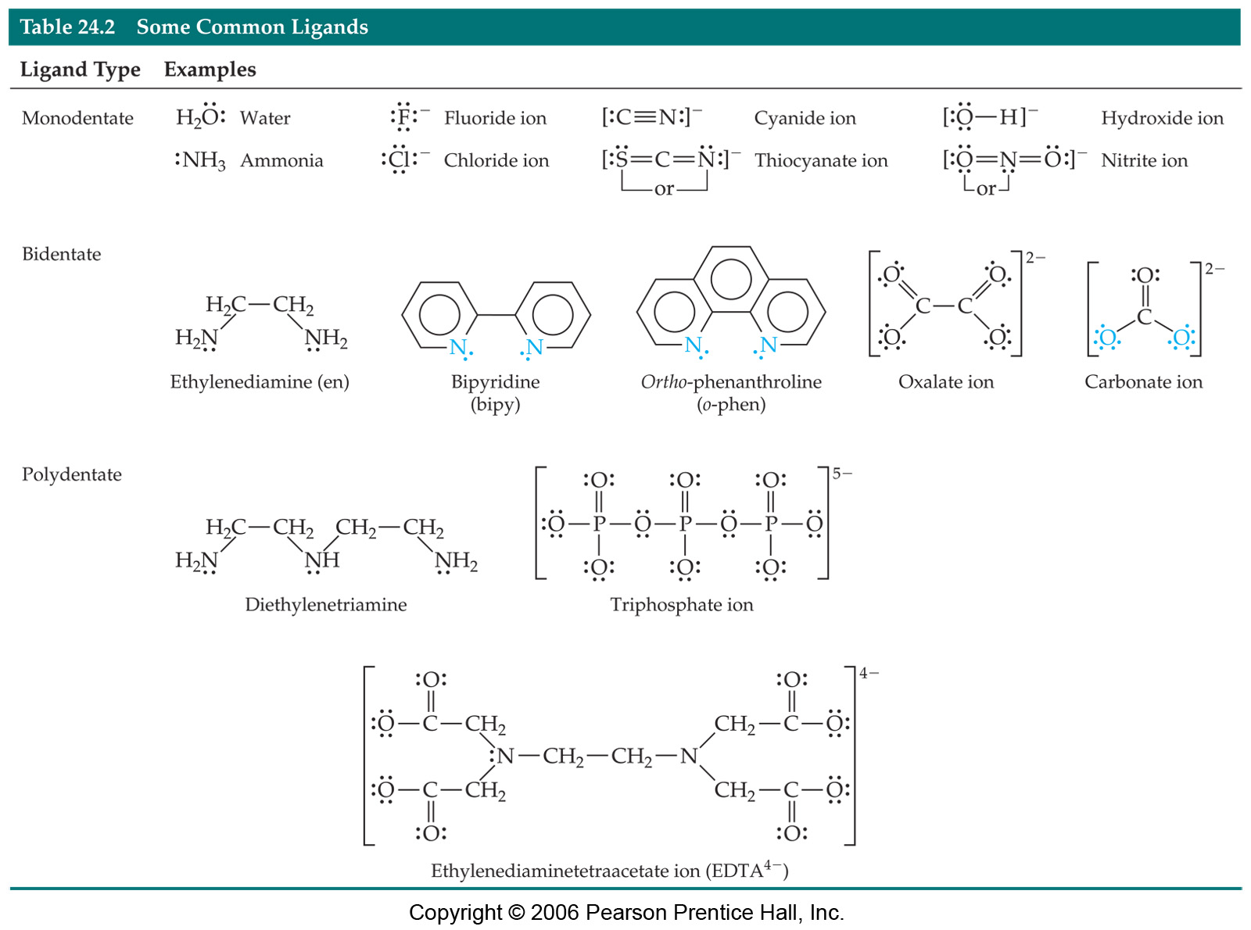
Polydentate Ligands
Chelating agents generally form more stable complexes than do monodentate ligands.

Slide 76
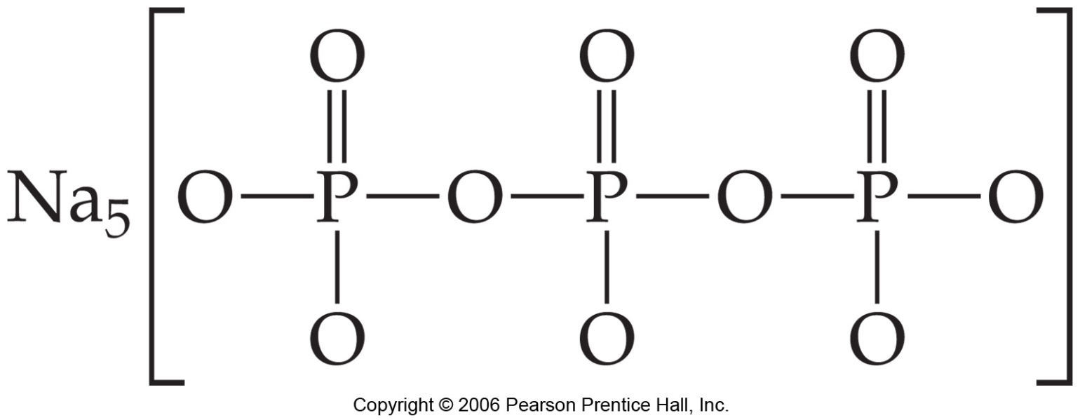
Chelating Agents
5-
-
..
..
-
:
:
..
..
:
:
:
:
:
:
..
..
..
-
-
-
Bind to metal ions removing them from solution.
Phosphates are used to tie up Ca²⁺ and Mg²⁺ in hard water to prevent them from interfering with detergents.

Slide 77
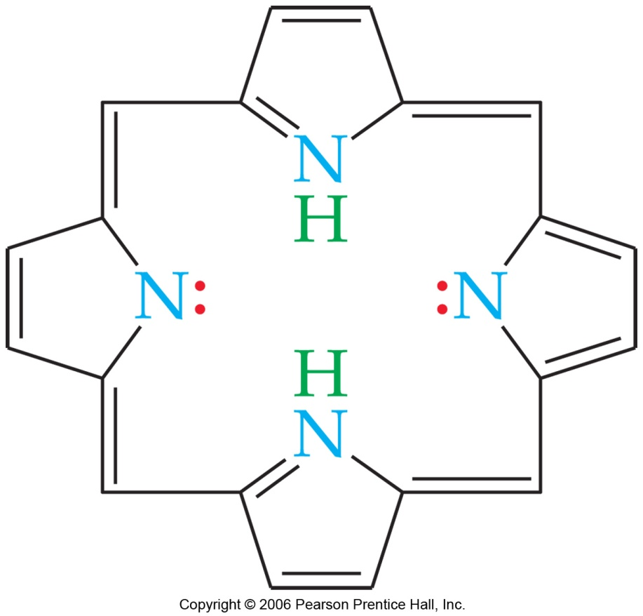
Chelating Agents
Porphyrins are complexes containing a form of the porphine molecule shown at right.
Important biomolecules like heme and chlorophyll are porphyrins.

Slide 78
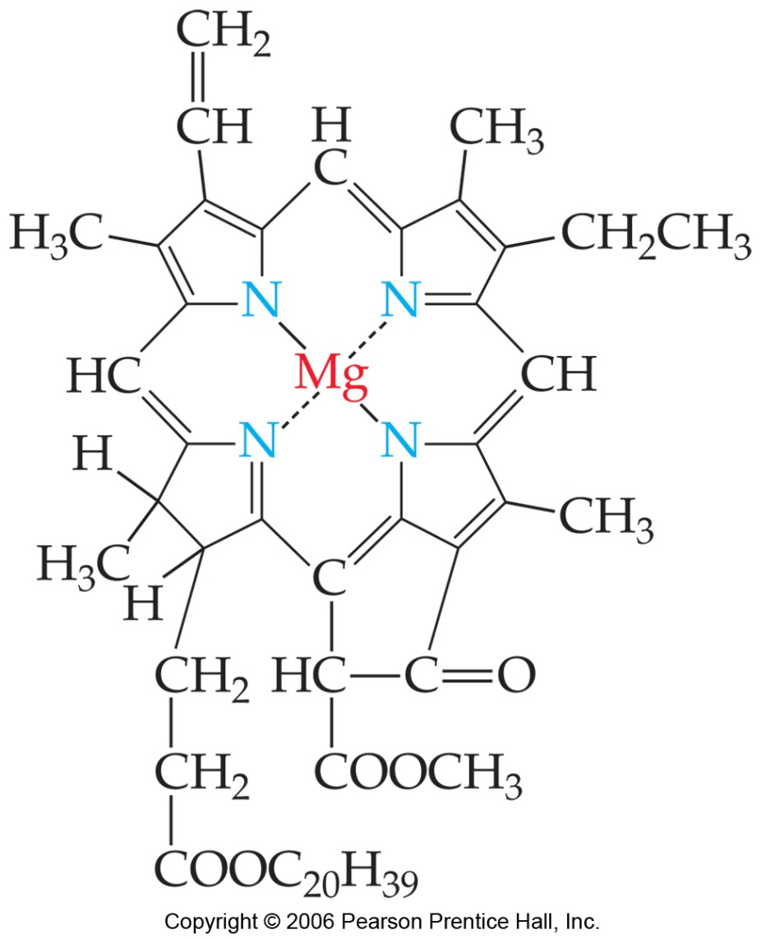
Chelating Agents
Porphines (like chlorophyll a) are tetradentate ligands.

Slide 79
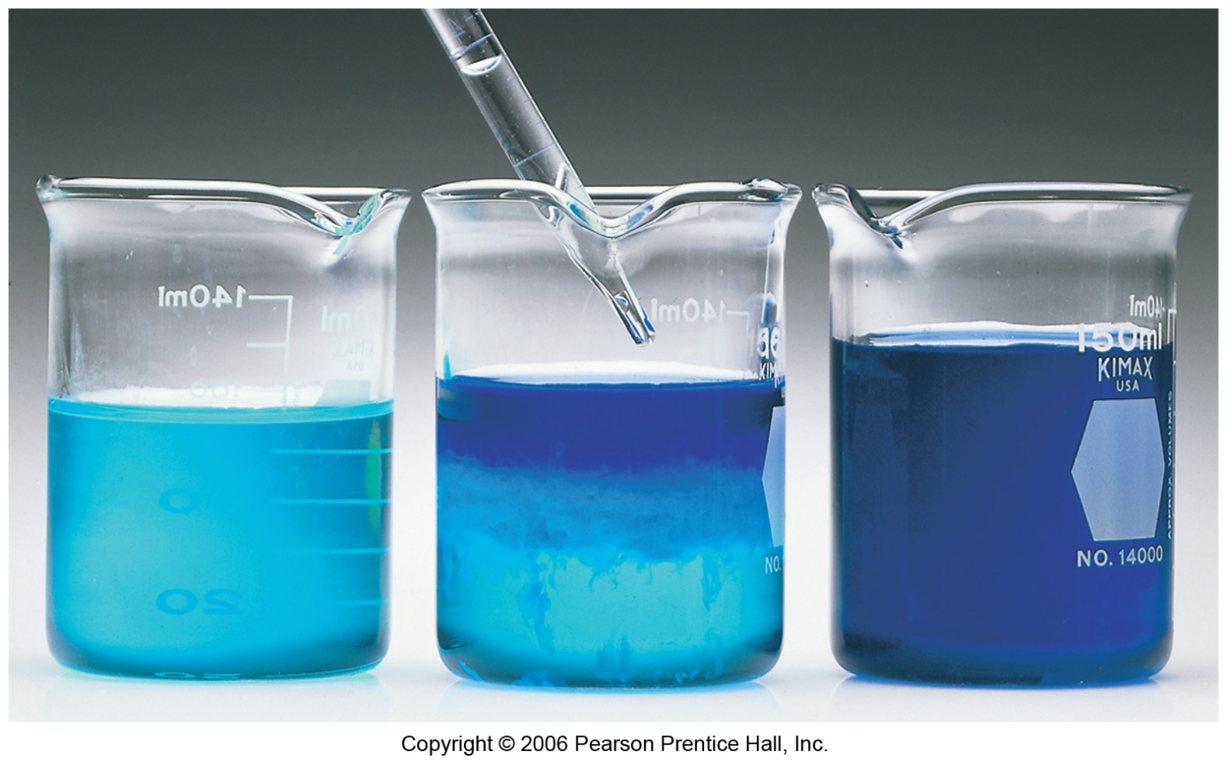
Metal complexes and color
The ligands of a metal complex effect its color
Addition of NH₃ ligand to Cu(H₂O)₄ changes its color
Notes:
Figure: 24-22
Title:
Effect of ligands on color.
Caption:
An aqueous solution of CuSO₄ is pale blue because of [Cu(H₂O)₄]²⁺ (left). When NH₃(aq) is added (middle and right), the deep blue [Cu(NH₃)₄]²⁺ ion forms.

Slide 80
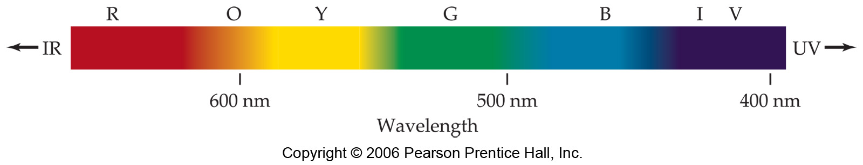
Why does anything have color?
Light of different frequencies give different colors
We learned that elements can emit light of different frequency or color.
But these coordination complexes are not emitting light
They absorb light.
How does that give color?
Notes:
Figure: 24-23
Title:
Visible spectrum.
Caption:
The relationship between color and wavelength for visible light.

Slide 81
Light can bounce off an object or get absorbed by object
No light absorbed, all reflected get white color
All light absorbed, none reflected get Black color
What if only one color is absorbed?

Slide 82
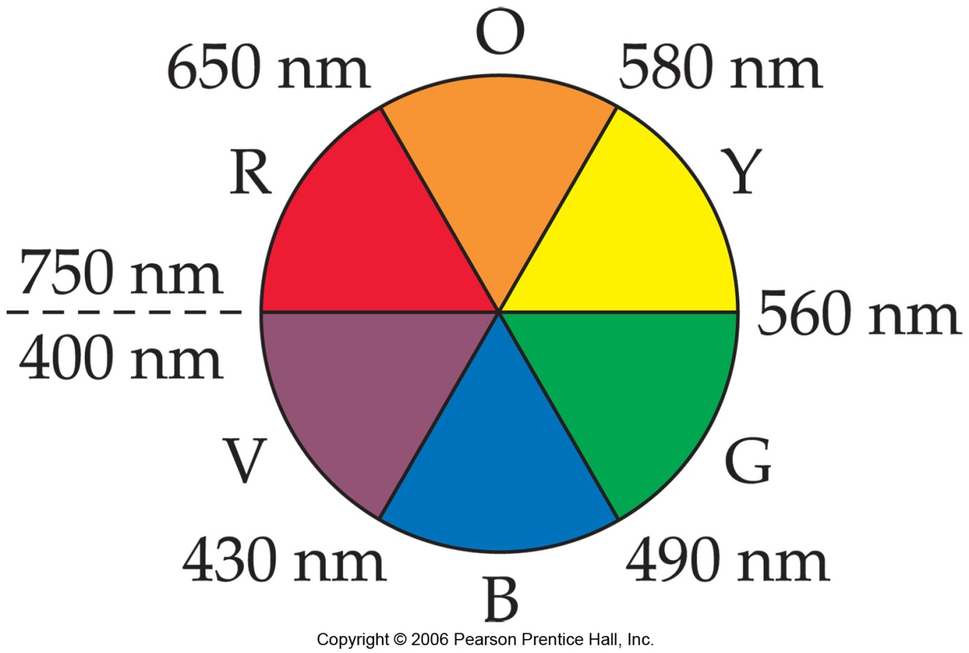
Complimentary color wheel
If one color absorbed, the color opposite is perceived.
Absorb Orange
See Blue
Absorb Red
See Green
Notes:
Figure: 24-24
Title:
Artist's color wheel.
Caption:
Colors with approximate wavelength ranges are shown as wedges. The colors that are complementary to each other lie opposite each other.

Slide 83
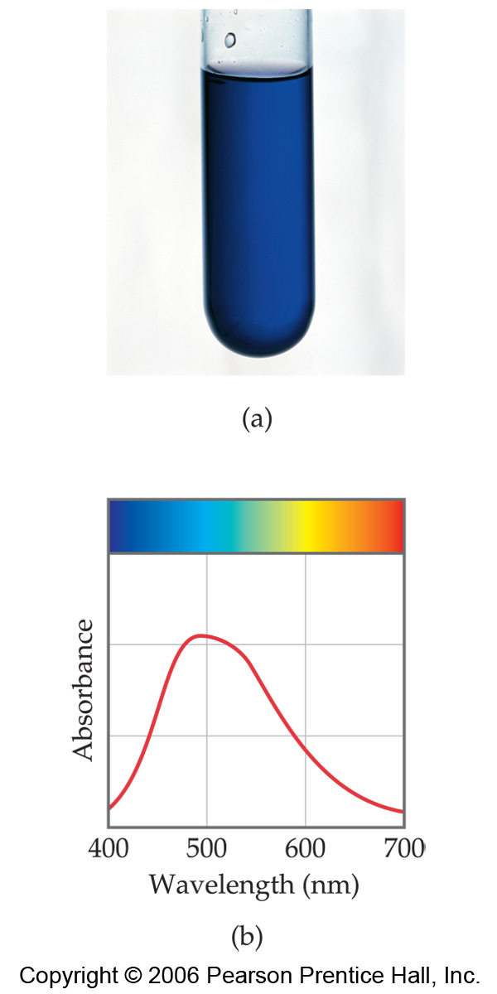
[Ti(H₂O)₆]³⁺
Absorbs in green yellow.
Looks purple.
Notes:
Figure: 24-26
Title:
The color of [Ti(H₂O)₆]³⁺.
Caption:
(a) A solution containing the [Ti(H₂O)₆]³⁺ ion. (b) The visible absorption spectrum of the [Ti(H₂O)₆]³⁺ ion.

Slide 84
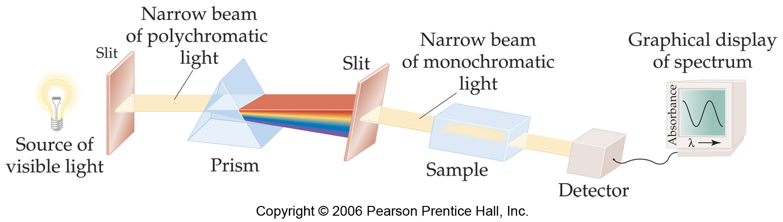
A precise measurement of the absorption spectrum of Compounds is critical
Notes:
Figure: 24-25
Title:
Experimental determination of the absorption spectrum of a solution.
Caption:
The prism is rotated so that different wavelengths of light pass through the sample. The detector measures the amount of light reaching it, and this information can be displayed as the absorption at each wavelength. The absorbance is a measure of the light absorbed.

Slide 85
Metal complexes and color
But why do different ligands on same metal give
Different colors?
Why do different ligands change absorption?
Addition of NH₃ ligand to Cu(H₂O)₄ changes its color
Notes:
Figure: 24-22
Title:
Effect of ligands on color.
Caption:
An aqueous solution of CuSO₄ is pale blue because of [Cu(H₂O)₄]²⁺ (left). When NH₃(aq) is added (middle and right), the deep blue [Cu(NH₃)₄]²⁺ ion forms.

Slide 86
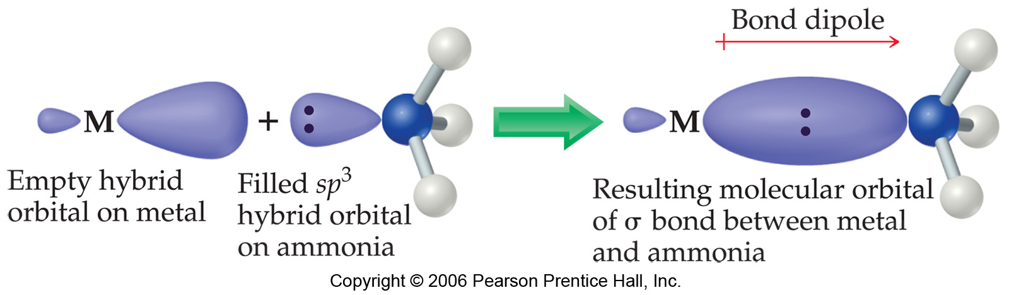
Model of ligand/metal bonding.
Electron pair comes from ligand
Bond very polarized.
Assumption: interaction pure electrostatic.
Notes:
Figure: 24-27
Title:
Metal-ligand bond formation.
Caption:
The ligand, which acts as a Lewis base, donates charge to the metal via a metal hybrid orbital. The bond that results is strongly polar, with some covalent character. It is often sufficient to assume that the metal-ligand interaction is entirely electrostatic in character, as is done in the crystal-field model.

Slide 87
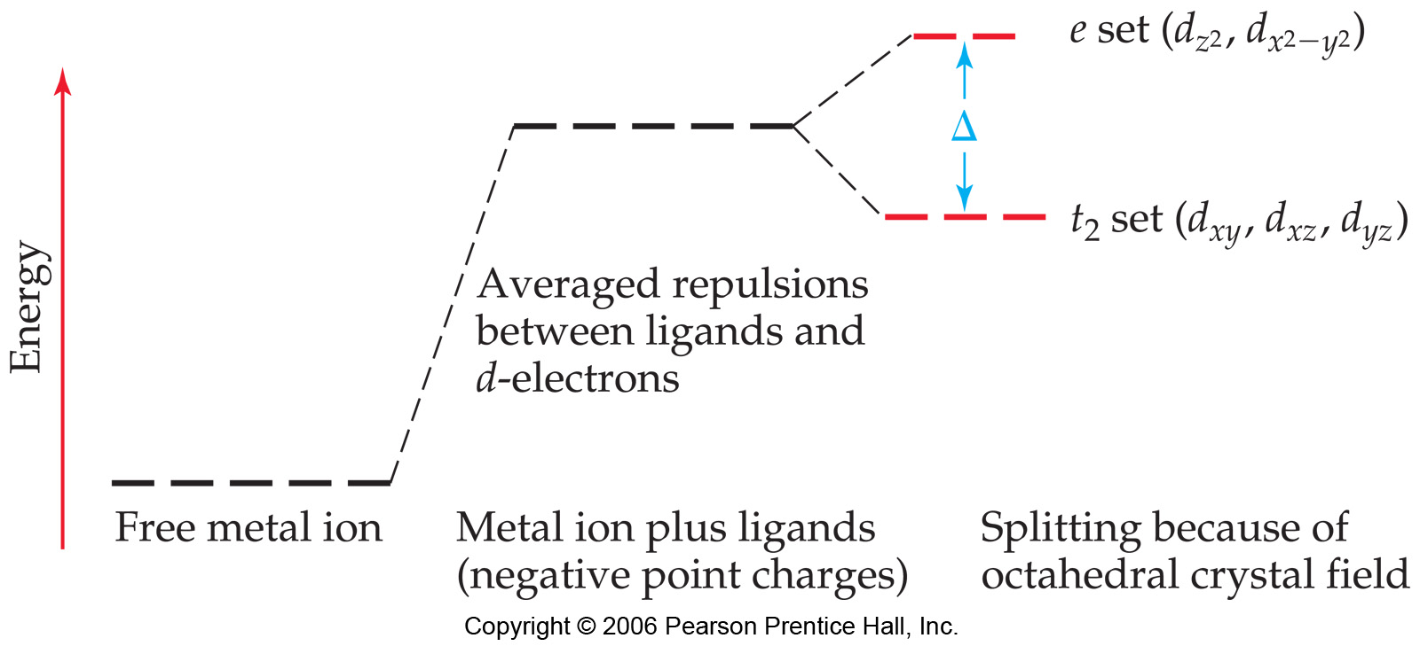
Now, think of point charges being attracted to metal nucleus
Positive charge. What about electrons in d orbitals?
Ligand negative charge
Is repelled by d electrons, d orbital energy goes up
Notes:
Figure: 24-28
Title:
Energies of d orbitals in an octahedral crystal field.
Caption:
On the left the energies of the d orbitals of a free ion are shown. When negative charges are brought up to the ion, the average energy of the d orbitals increases (center). On the right the splitting of the d orbitals due to the octahedral field is shown. Because the repulsion felt by the d_{z2} and d_{x2–y2} orbitals is greater than that felt by the d_{xy}, d_{xz}, and d_{yz} orbitals, the five d orbitals split into a lower-energy set of three (the t₂ set) and a higher-energy set of two (the e set).

Slide 88
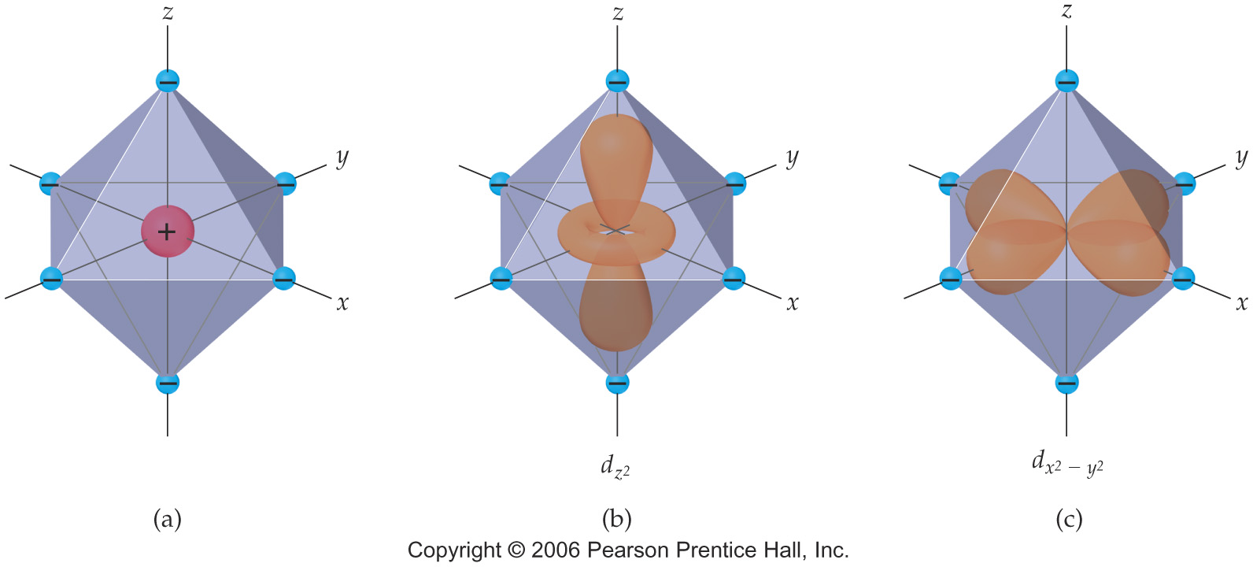
Ligands will interact with some d orbitals more than others
Depends on relative orientation of orbital and ligand
Ligands point right at lobes
Notes:
Figure: 24-29abc
Title:
The five d orbitals in an octahedral crystal field.
Caption:
(a) An octahedral array of negative charges approaching a metal ion. (b) The orientations of the d orbitals relative to the negative charges. Notice that the lobes of the d_{z2} and d_{x2–y2} orbitals (b and c) point toward the charges, whereas the lobes of the d_{xy}, d_{yz}, and d_{xz} orbitals (d–f) point between the charges.

Slide 89
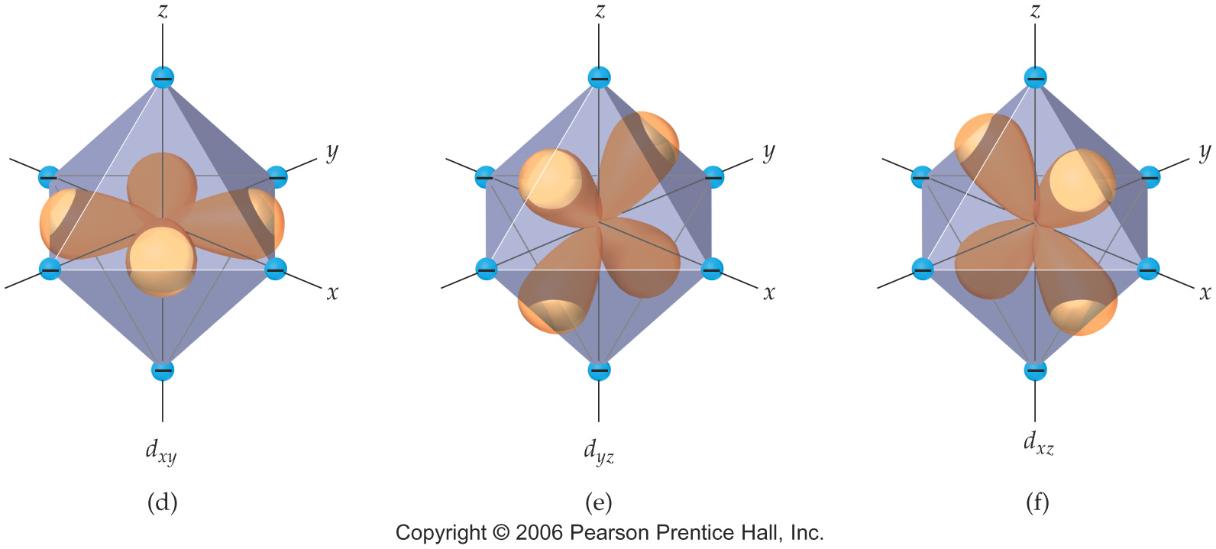
In these orbitals, the ligands are between the lobes
Interact less strongly
Notes:
Figure: 24-29def
Title:
The five d orbitals in an octahedral crystal field.
Caption:
(a) An octahedral array of negative charges approaching a metal ion. (b) The orientations of the d orbitals relative to the negative charges. Notice that the lobes of the d_{z2} and d_{x2–y2} orbitals (b and c) point toward the charges, whereas the lobes of the d_{xy}, d_{yz}, and d_{xz} orbitals (d–f) point between the charges.

Slide 90
Splitting due to ligand/orbirtal orientation.

Slide 91
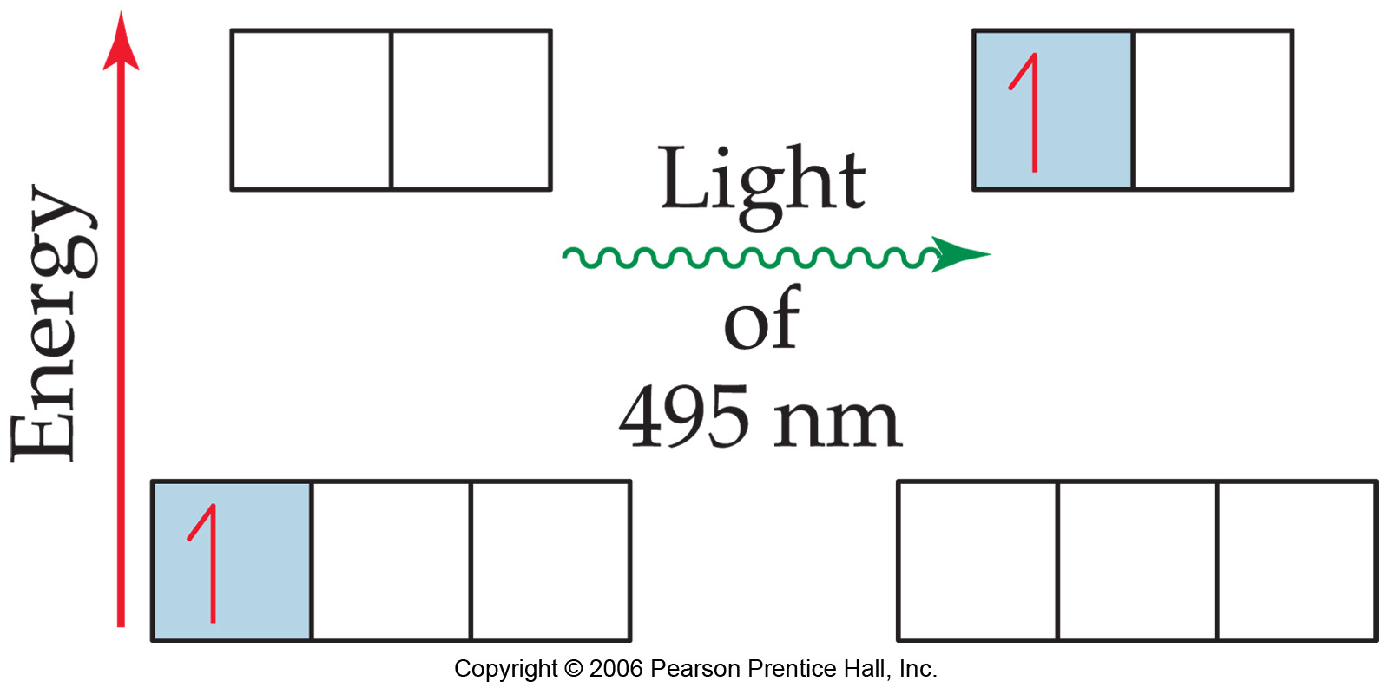
= 495 nm
Notes:
Figure: 24-30
Title:
Electronic transition accompanying absorption of light.
Caption:
The 3d electron of [Ti(H₂O)₆]³⁺ is excited from the lower-energy d orbitals to the higher-energy ones when irradiated with light of 495-nm wavelength.

Slide 92
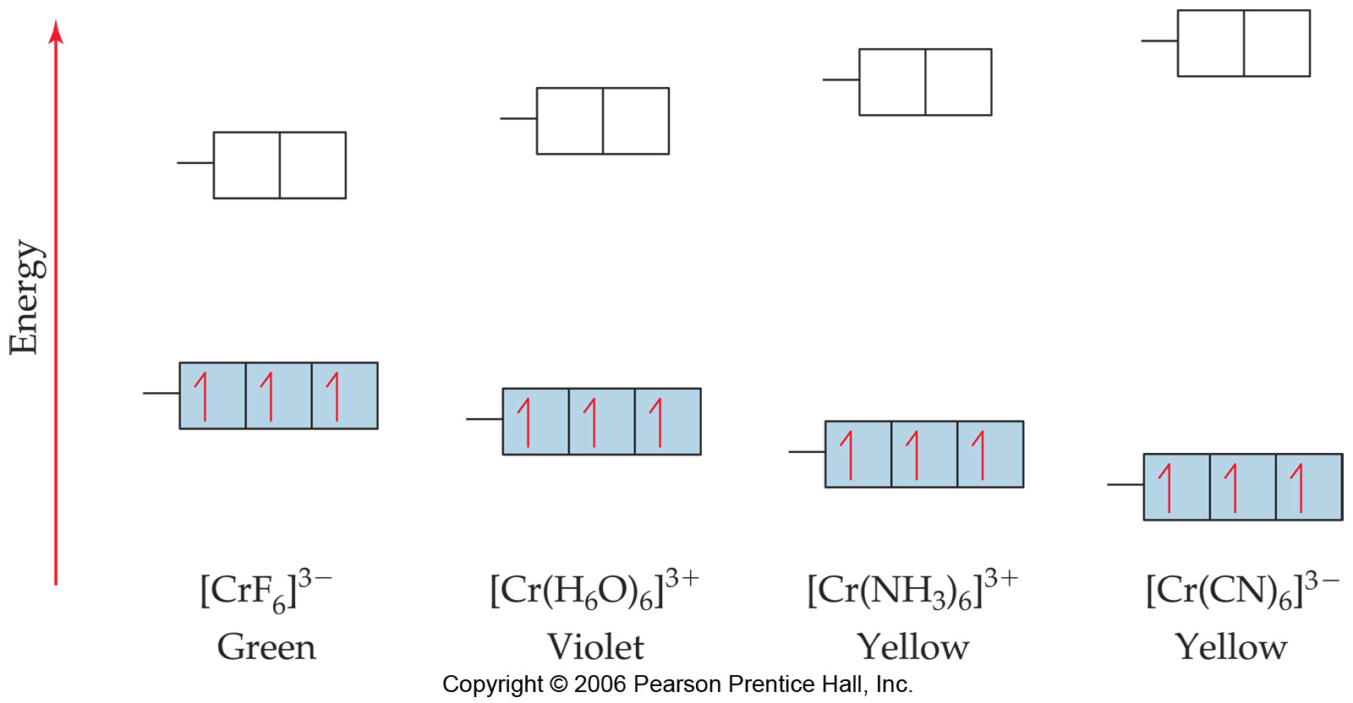
Different ligands interact more or less, change E spacing
Of D orbitals.
Notes:
Figure: 24-31
Title:
Effect of ligand on crystal-field splitting.
Caption:
This series of octahedral chromium(III) complexes illustrates how Δ, the energy gap between the t₂ and e orbitals, increases as the field strength of the ligand increases.

Slide 93
Spectrochemical series (strength of ligand interaction)
Increasing Δ
Cl⁻ < F⁻ < H₂O < NH₃ < en < NO₂⁻ < CN⁻
Increasing Δ

Slide 94
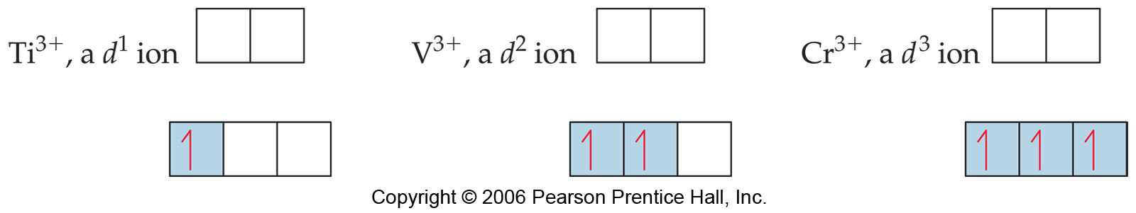
Electron configurations of some octahedral complexes
Notes:
eleFigure: 24-32
Title:
Electron configurations in octahedral complexes.
Caption:
Orbital occupancies are shown for complexes with one, two, and three d electrons in an octahedral crystal field.

Slide 95

As Energy difference increases, electron configuration
changes
“Low spin”
“High spin”
Co(III) is d⁶
Notes:
Figure: 24-33
Title:
High-spin and low-spin complexes.
Caption:
Population of d orbitals in the high-spin [CoF₆]^{3–} ion (small Δ)and low-spin [Co(CN)₆]^{3–} ion (large Δ). Both complexes contain cobalt(III), which has six 3d electrons, 3d⁶.

Slide 96

Notes:
Figure: 24-33-01UN
Title:
Sample Exercise 24.9
Caption:
Orbital diagrams.

Slide 97

Tetrahedral Complexes
In tetrahedral complexes, orbitals are inverted.
Again because of orientation of orbitals and ligands
Δ is always small, always low spin (less ligands)
Notes:
Figure: 24-34
Title:
Tetrahedral crystal field.
Caption:
Energies of the d orbitals in a tetrahedral crystal field

Slide 98

Square planar complexes are different still
Notes:
Figure: 24-35
Title:
Energies of the d orbitals in a square-planar crystal field.
Caption:
The boxes on the left show the energies of the d orbitals in an octahedral crystal field. As the two negative charges along the z-axis are removed, the energies of the d orbitals change, as indicated by the lines between the boxes. When the charges are completely removed, the square-planar geometry results, giving the splitting of d-orbital energies represented by the boxes on the right.

Slide 99




Slide 100

Notes:
Figure: 24-35-01UNEx10
Title:
Sample Exercise 24.10
Caption:
Orbital diagrams of tetrahedral and square planar–complexes.

Slide 101

Intense color can come from “charge transfer”
Ligand electrons jump to metal orbitals
KMnO₄
KCrO₄
KClO₄
No d orbitals in
Cl, orbitals higher
In energy
Notes:
Figure: 24-36
Title:
Effect of charge-transfer transitions.
Caption:
The compounds KMnO₄, K₂CrO₄, and KClO₄ are shown from left to right. The KMnO₄ and K₂CrO₄ are intensely colored because of ligand-to-metal charge transfer (LMCT) transitions in the MnO₄– and CrO₄^{2–} anions. There are no valence d orbitals on Cl, so the charge-transfer transition for ClO₄– requires ultraviolet light and KClO₄ is white.

Slide 102

Notes:
Figure: 24-37
Title:
Ligand-to-metal charge transfer (LMCT) transition in MnO₄–.
Caption:
As shown by the blue arrow, an electron is excited from a nonbonding pair on O into one of the empty d orbitals on Mn.

Slide 103
Exam 4, MO theory and coordination compounds
Chapter 9, end and Chapter 24.
MO theory: Rules:
1. The number of MO’s equals the # of Atomic orbitals
2. The overlap of two atomic orbitals gives two molecular orbitals, 1 bonding, one antibonding
3. Atomic orbitals combine with other atomic orbitals of similar energy.
4. Degree of overlap matters. More overlap means bonding orbital goes lower in E, antibonding orbital goes higher in E.
5. Each MO gets two electrons
6. Orbitals of the same energy get filled 1 electron at a time until they are filled.

Slide 104

Difference between pi and sigma orbitals
End on
Side to side.

Slide 105

A typical MO diagram, like the one below. For 2p and 2s atomic orbital mixing.

Slide 106

Oxygen O₂ is Paramagnetic, why?

Slide 107

Show me why.

Slide 108
Exam 4 Chapter 24.
Concentrate on the homeworks and the quiz!
Terms:
Coordination sphere
Ligand
Coordination compound
Metal complex
Complex ion
Coordination
Coordination number
Same ligands different properties?
Figuring oxidation number on metal

Slide 109
Polydentate ligands (what are they)?
Isomers.
structural isomers (formula same, bonds differ)
geometric isomers (formula AND bonds same, structure differs)
Stereoisomers:
Chirality, handedness,

Slide 110




Slide 111


Stereoisomers

Slide 112
Explaining the properties of metal complexes
Magnetism and color
How does seeing color work?
Absorb Orange
See Blue
Absorb Red
See Green

Slide 113
Different ligands on same metal give different colors
Addition of NH₃ ligand to Cu(H₂O)₄ changes its color

Slide 114


Splitting of d orbitals in an oxtahedral ligand field
d_{z}² d_{x}²_{-y}²
d_{xy} d_{yz} d_{xz}

Slide 115
Spectrochemical series (strength of ligand interaction)
Increasing Δ
Cl⁻ < F⁻ < H₂O < NH₃ < en < NO₂⁻ < CN⁻
Increasing Δ
Know low spin versus high spin

Slide 116
There is also splitting from tetrahedral
And square planar. Know they are different, don’t remember exactly what they are like.

Slide 117


Slide 118


Slide 119


Slide 120
Crystal Field Theory
Focus: energies of the d orbitals
Assumptions
1. Ligands: negative point charges
2. Metal-ligand bonding: entirely ionic
strong-field (low-spin): large splitting of d orbitals
weak-field (high-spin): small splitting of d orbitals

Slide 121


Slide 122


Slide 123
Δ = crystal field splitting

Slide 124

High spin
Low spin

Slide 125


Slide 126


Slide 127


Slide 128

[V(H₂O)₆]²⁺
[V(H₂O)₆]³⁺
[Cr(NH₃)₆]³⁺
[Cr(NH₃)₅Cl]^{2+s}

Slide 129


Slide 130


Slide 131


Slide 132
Tetrahedral Complexes

Slide 133


Slide 134
Square Planar & Linear Complexes
Approach along x-and y-axes
Approach along z-axis

Slide 135
Example 2
Superimposable-not enantiomers
trans-[Co(en)₂Cl₂]⁺

Slide 136
Properties of Optical Isomers
Enantiomers
possess many identical properties
solubility, melting point, boiling point, color, chemical reactivity (with nonchiral reagents)
different in:
interactions with plane polarized light

Slide 137
Optical Isomers
polarizing filter
plane polarized light
optically active sample in solution
Dextrorotatory (d) = right rotation
Levorotatory (l) = left rotation
Racemic mixture = equal amounts of two enantiomers; no net rotation
rotated polarized light

Slide 138
Properties of Optical Isomers
Enantiomers
possess many identical properties
solubility, melting point, boiling point, color, chemical reactivity (with nonchiral reagents)
different in:
interactions with plane polarized light
reactivity with “chiral” reagents
Example
d-C₄H₄O₆²⁻(aq) + d,l-[Co(en)₃]Cl₃(aq) →
d-[Co(en)₃](d-C₄H₄O₆²⁻ )Cl(s) + l-[Co(en)₃]Cl₃(aq) +2Cl⁻(aq)

Slide 139
Properties of Transition Metal Complexes
Properties of transition metal complexes:
usually have colour
dependent upon ligand(s) and metal ion
many are paramagnetic
due to unpaired d electrons
degree of paramagnetism dependent on ligand(s)
[Fe(CN)₆]³⁻ has 1 unpaired d electron
[FeF₆]³⁻ has 5 unpaired d electrons

Slide 140
Crystal Field Theory
Crystal Field Theory
Model for bonding in transition metal complexes
Accounts for observed properties of transition metal complexes
Focuses on d-orbitals
Ligands = point negative charges
Assumes ionic bonding
electrostatic interactions

Slide 141
d orbitals

Slide 142
Crystal Field Theory
Electrostatic Interactions
(+) metal ion attracted to (-) ligands (anion or dipole)
provides stability
lone pair e⁻’s on ligands repulsed by e⁻’s in metal d orbitals
interaction called crystal field
influences d orbital energies
not all d orbitals influenced the same way

Slide 143
Crystal Field Theory
-
Octahedral Crystal Field
-
-
(-) Ligands attracted to (+) metal ion; provides stability
+
-
-
d orbital e⁻’s repulsed by (–) ligands; increases d orbital potential energy
-
ligands approach along x, y, z axes

Slide 144


Slide 145
Crystal Field Theory
Lobes directed at ligands
greater electrostatic repulsion = higher potential energy

Slide 146
Crystal Field Theory
Lobes directed between ligands
less electrostatic repulsion = lower potential energy

Slide 147
metal ion in octahedral complex
octahedral crystal field
d orbital energy levels
d_{z}2
d_{x}2_{- y}2
_ _
Δ
_ _ _
E
d_{xy}
d_{xz}
d_{yz}
isolated metal ion
_ _ _ _ _
Metal ion and the nature of the ligand determines Δ
d-orbitals

Slide 148


Slide 149
Spectrochemical Series
Colours of Transition Metal Complexes
Smallest Δ
Δ increases
Largest Δ
I⁻ < Br⁻ < Cl⁻ < OH⁻ < F⁻ < H₂O < NH₃ < en < CN⁻
strong field
weak field

Slide 150
Coordination Chemistry
Bonding in transition-metal complexes

Slide 151
The chemistry of d orbitals

Slide 152
Crystal field theory: an electrostatic model
The metal ion will be positive and therefore attract the negatively charged ligands
But there are electrons in the metal orbitals, which will experience repulsions
with the negatively charged ligands

Slide 153

Ligand/d orbital interactions
Orbitals point at ligands
(maximum repulsion)
Orbitals point
between ligands
(less pronounced repulsion)

Slide 154

The two effects of the crystal field

Slide 155

Splitting of d orbitals in an octahedral field
e_{g}
3/5 Δo
Δo
2/5 Δo
t_{2g}
Δo is the crystal field splitting
E(t_{2g}) = -0.4Δo x 3 = -1.2Δo
E(e_{g}) = +0.6Δo x 2 = +1.2Δo

Slide 156
The magnitude of the splitting
(ligand effect)
Weak
field
Strong
field
The spectrochemical series
CO, CN⁻ > phen > NO₂⁻ > en > NH₃ > NCS⁻ > H₂O > F⁻ > RCO₂⁻ > OH₋ > Cl⁻ > Br⁻ > I⁻

Slide 157
The magnitude of the splitting
(metal ion effect)
Weak
field
Strong
field
increases with increasing formal charge on the metal ion
increases on going down the periodic table

Slide 158

The splitting constant must depend on both the ligand and the metal.
Δ_{o} ≈ M ∑ n_{l}L_{l} x 10³
Predicts value of Δ (cm⁻¹)
n_{l} is # of ligands L_{l}

Slide 159
Placing electrons in d orbitals
Strong field Weak field
Strong field Weak field
d¹
d²
d³
d⁴

Slide 160
When the 4th electron is assigned it will either go into the higher energy e_{g} orbital at an energy cost of Δ₀ or be paired at an energy cost of Π, the pairing energy.
d⁴
Strong field =
Low spin
(2 unpaired)
Weak field =
High spin
(4 unpaired)
Π < Δ_{o}
Π > Δ_{o}
Notes: the pairing energy, P, is made up of two parts. 1) Coulombic repulsion energy caused by having two electrons in same orbital

Slide 161
Pairing Energy, Π
The pairing energy, Π, is made up of two parts.
Coulombic repulsion energy caused by having two electrons in same orbital. Destabilizing energy contribution of Π_{c} for each doubly occupied orbital.
Exchange stabilizing energy for each pair of electrons having the same spin and same energy. Stabilizing contribution of Π_{e} for each pair having same spin and same energy
Π = sum of all Π_{c} and Π_{e} interactions

Slide 162
Placing electrons in d orbitals
d⁵
d⁶
d⁷
1 u.e.
5 u.e.
0 u.e.
4 u.e.
1 u.e.
3 u.e.
d⁸
d⁹
d¹⁰
2 u.e.
2 u.e.
1 u.e.
1 u.e.
0 u.e.
0 u.e.

Slide 163

Positive favors high spin. Neg favors low spin.

Slide 164
Enthalpy of Hydration of hexahydrate

Slide 165
Splitting of d orbitals in a tetrahedral field
t₂
Δt
e
Δ_{t} = 4/9Δ_{o}
Always weak field (high spin)

Slide 166
Magnetic properties of metal complexes
Diamagnetic complexes
very small repulsive interaction with external magnetic field
no unpaired electrons
Paramagnetic complexes
attractive interaction with external magnetic field
some unpaired electrons

Slide 167

Measured magnetic moments include contributions from both spin and orbital spin. In the first transition series complexes the orbital contribution is small and usually ignored.

Slide 168
Coordination Chemistry:
Molecular orbitals for metal complexes

Slide 169



The symmetry of metal orbitals in an octahedral environment
A_{1g}
T_{1u}

Slide 170

The symmetry of metal orbitals in an octahedral environment
T_{2g}
E_{g}

Slide 171

The symmetry of metal orbitals in an octahedral environment
s

Slide 172
Metal-ligand σ interactions in an octahedral environment
Six ligand orbitals of σ symmetry approaching the metal ion along the x,y,z axes
We can build 6 group orbitals of σ symmetry as before
and work out the reducible representation

Slide 173

s
If you are given Γ, you know by now how to get the irreducible representations
Γ = A_{1g} + T_{1u} + E_{g}

Slide 174
Now we just match the orbital symmetries
s

Slide 175

“d⁰-d¹⁰ electrons”
anti bonding
“metal character”
non bonding
6 σ ligands x 2e each
12 σ bonding e
“ligand character”

Slide 176


Introducing π-bonding
2 orbitals of π-symmetry
on each ligand
We can build 12 group orbitals
of π-symmetry

Slide 177

Γ_{π} = T_{1g} + T_{2g} + T_{1u} + T_{2u}

Slide 178

Anti-bonding LUMO(π)
The CN- ligand

Slide 179

Some schematic diagrams showing how p bonding occurs with a ligand having a d orbital (P), a π* orbital, and a vacant p orbital.

Slide 180
ML₆ σ-only bonding
“d⁰-d¹⁰ electrons”
anti bonding
“metal character”
non bonding
The bonding orbitals, essentially the ligand lone pairs,
will not be worked with further.
6 σ ligands x 2e each
12 σ bonding e
“ligand character”

Slide 181
π-bonding may be introduced
as a perturbation of the t_{2g}/e_{g} set:
Case 1 (CN⁻, CO, C₂H₄)
empty π-orbitals on the ligands
M→L π-bonding (π-back bonding)
t_{2g} (π*)
t_{2g}
e_{g}
e_{g}
Δo
Δ’o
Δ_{o} has increased
t_{2g}
Stabilization
t_{2g} (π)
ML₆
σ-only
ML₆
σ + π
(empty π-orbitals on ligands)

Slide 182
π-bonding may be introduced
as a perturbation of the t_{2g}/e_{g} set.
Case 2 (Cl⁻, F⁻)
filled π-orbitals on the ligands
L→M π-bonding
e_{g}
e_{g}
Δ’o
t_{2g} (π*)
Δ_{o} has decreased
Δo
Destabilization
t_{2g}
t_{2g}
Stabilization
t_{2g} (π)
ML₆
σ-only
ML₆
σ + π
(filled π-orbitals)

Slide 183

Putting it all on one diagram.
Strong field / low spin
Weak field / high spin

Slide 184
Spectrochemical Series
Purely σ ligands:
Δ: en > NH₃ (order of proton basicity)
donating which decreases splitting and causes high spin:
Δ: H₂O > F > RCO₂ > OH > Cl > Br > I (also proton basicity)
Adding in water, hydroxide and carboxylate
Δ: H₂O > F > RCO₂ > OH > Cl > Br > I
π accepting ligands increase splitting and may be low spin
Δ: CO, CN⁻, > phenanthroline > NO₂⁻ > NCS⁻

Slide 185
Merging to get spectrochemical series
CO, CN⁻ > phen > en > NH₃ > NCS⁻ > H₂O > F⁻ > RCO₂⁻ > OH⁻ > Cl⁻ > Br⁻ > I⁻
Weak field, π donors small Δ high spin
Strong field, π acceptors large Δ low spin
σ only

Slide 186
Turning to Square Planar Complexes
Most convenient to use a local coordinate system on each ligand with
y pointing in towards the metal. p_{y} to be used for σ bonding.
z being perpendicular to the molecular plane. p_{z} to be used for π bonding perpendicular to the plane, π⊥.
x lying in the molecular plane. p_{x} to be used for π bonding in the molecular plane, π|.

Slide 187

ML₄ square planar complexes
ligand group orbitals and matching metal orbitals

Slide 188




ML₄ square planar complexes
MO diagram
σ-only bonding
π- bonding

Slide 189

A crystal-field aproach: from octahedral to tetrahedral
Less repulsions along the axes
where ligands are missing

Slide 190

A crystal-field aproach: from octahedral to tetrahedral
A correction to preserve
center of gravity

Slide 191
The Jahn-Teller effect
Jahn-Teller theorem:
“there cannot be unequal occupation of orbitals with identical energy”
Molecules will distort to eliminate the degeneracy

Slide 192



Slide 193
Angular Overlap Method
An attempt to systematize the interactions for all geometries.
The various complexes may be fashioned out of the ligands above
Linear: 1,6
Trigonal: 2,11,12
T-shape: 1,3,5
Tetrahedral: 7,8,9,10
Square planar: 2,3,4,5
Trigonal bipyramid: 1,2,6,11,12
Square pyramid: 1,2,3,4,5
Octahedral: 1,2,3,4,5,6

Slide 194
Cont’d
All σ interactions with the ligands are stabilizing to the ligands and destabilizing to the d orbitals. The interaction of a ligand with a d orbital depends on their orientation with respect to each other, estimated by their overlap which can be calculated.
The total destabilization of a d orbital comes from all the interactions with the set of ligands.
For any particular complex geometry we can obtain the overlaps of a particular d orbital with all the various ligands and thus the destabilization.

Slide 195
ligand | d_{z2} | d_{x2-y2} | d_{xy} | d_{xz} | d_{yz}
1 | 1 e_{σ} | 0 | 0 | 0 | 0
2 | ¼ | ¾ | 0 | 0 | 0
3 | ¼ | ¾ | 0 | 0 | 0
4 | ¼ | ¾ | 0 | 0 | 0
5 | ¼ | ¾ | 0 | 0 | 0
6 | 1 | 0 | 0 | 0 | 0
7 | 0 | 0 | 1/3 | 1/3 | 1/3
8 | 0 | 0 | 1/3 | 1/3 | 1/3
9 | 0 | 0 | 1/3 | 1/3 | 1/3
10 | 0 | 0 | 1/3 | 1/3 | 1/3
11 | ¼ | 3/16 | 9/16 | 0 | 0
12 | 1/4 | 3/16 | 9/16 | 0 | 0
Thus, for example a d_{x2-y2} orbital is destabilized by (3/4 +6/16) e_{σ} = 18/16 e_{σ} in a trigonal bipyramid complex due to σ interaction. The d_{xy}, equivalent by symmetry, is destabilized by the same amount. The d_{z2} is destabililzed by 11/4 e_{σ}.

